Slide 1

Embedding Compression for Dense Retrieval: A Controlled Comparison of Post-hoc, Training-time, and Stacked Methods
Sajil Awale
Advisor - Dr. Tathagata Mukherjee
June 11, 2026
Notes:
Good Morning ! Thank you for being here.
I am Sajil Awale and today I will be presenting my thesis on Embedding Compression for Dense Retrieval.
We compare various compression techniques that we organized as Post-hoc, training time and stacked methods.
I am also grateful to Dr T for advising my thesis

Slide 2
Outline
Introduction
Background
Related Works
Methodology
Results and Findings
Conclusion and Future Work
Notes:
Introduction: My motivation and the problem statement.
Background: Key concepts needed to understand & appreciate the results.
Literature Review: Prior studies and our unique contribution.
Methodology: Our experimental setup for a fair comparison.
Results: The outcomes of our evaluations.
Conclusion: Revisiting objectives, limitations, and future work

Slide 3
Introduction

Slide 4
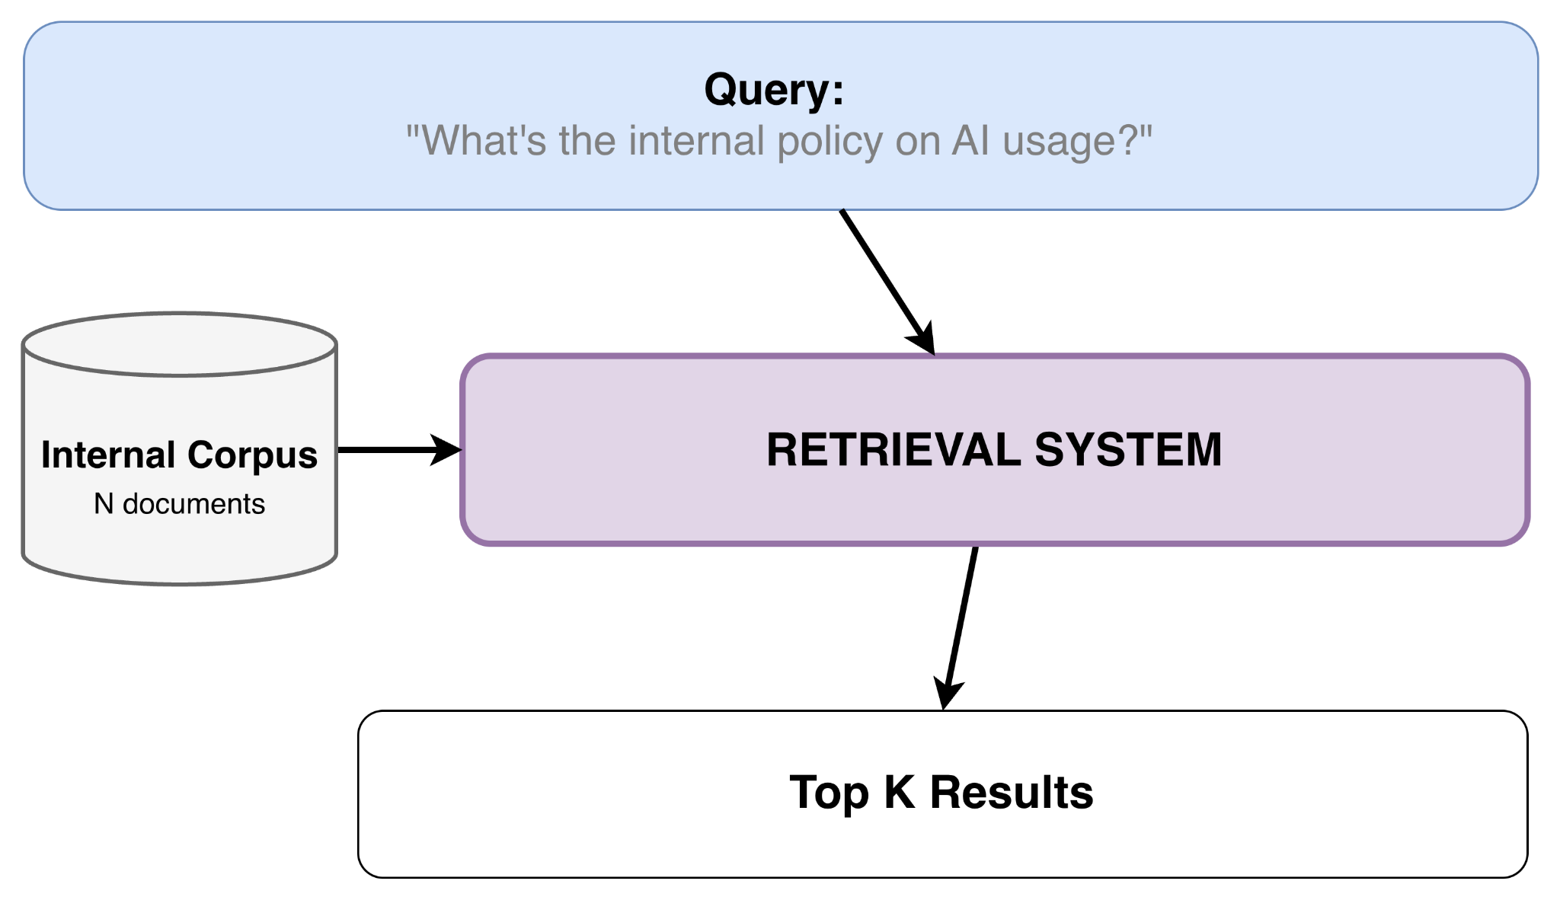
What is Retrieval System?
Introduction
Notes:
The Core Concept: Explain the flowchart (Query → System → Top K Results).
The Analogy: Compare it to Google Search (you enter a query, you get ranked websites).
The Application: In our case, the system searches an internal corpus to bring back the most relevant documents.

Slide 5
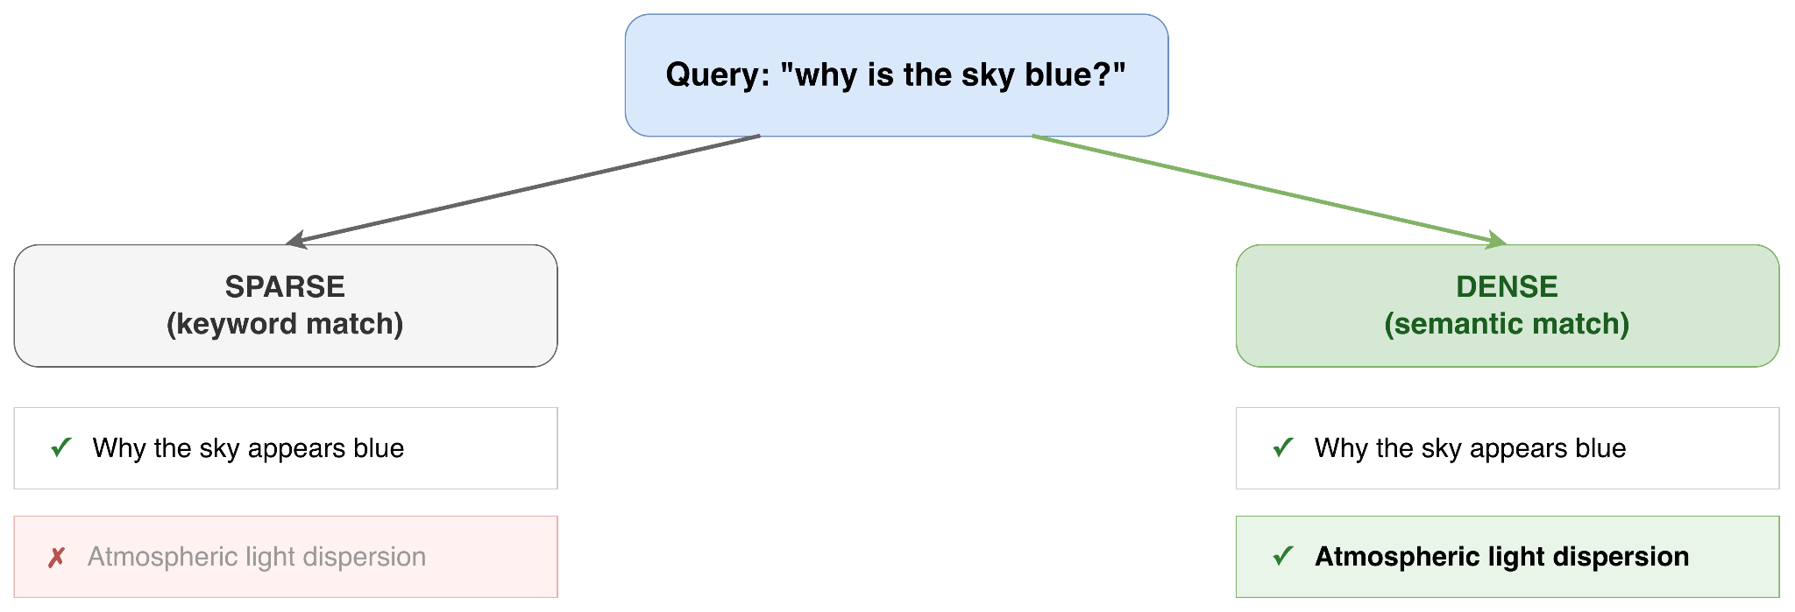
Types of Retrieval System
Introduction
From keyword to meaning
Notes:
The Two Types: Introduce Sparse vs. Dense retrieval.
Sparse (Keyword Match): Looks for exact words. Point to the diagram: It misses "light dispersion" because the words don't match.
Dense (Semantic Match): Moves from keywords to meaning. Point to the diagram: It successfully links the query to "light dispersion" because it understands the concept.

Slide 6
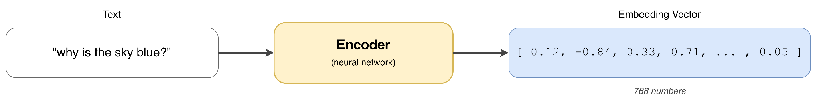
How does Modern Dense Retrieval Work ?
Introduction
Encoder: Foundation for Modern Dense Retrieval System
Text to Vectors
Similar meaning have similar vectors
Notes:
The foundation of Modern Dense retrieval system is the encoder.
The encoder is a neural network. It takes in text and generates bunch of floating numbers we call embeddings that capture the semantic meaning of the text
Which means text with similar meaning have similar vector.

Slide 7
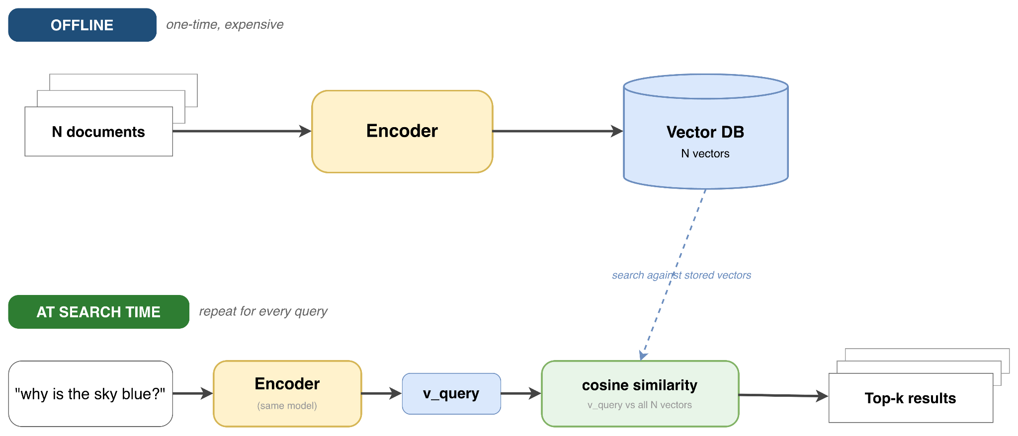
Pipeline for Dense Retrieval System (Bi-Encoder)
Introduction
Encode once, search many times
Notes:
search many times."
Phase 1: Offline (Point to top): Explain that it's a one-time, heavy process. We encode millions of documents and store them in a Vector DB.
Phase 2: Online/Search Time (Point to bottom): Explain that this repeats for every query. We encode the specific question, run a cosine similarity check against the database, and output the Top-K results.

Slide 8
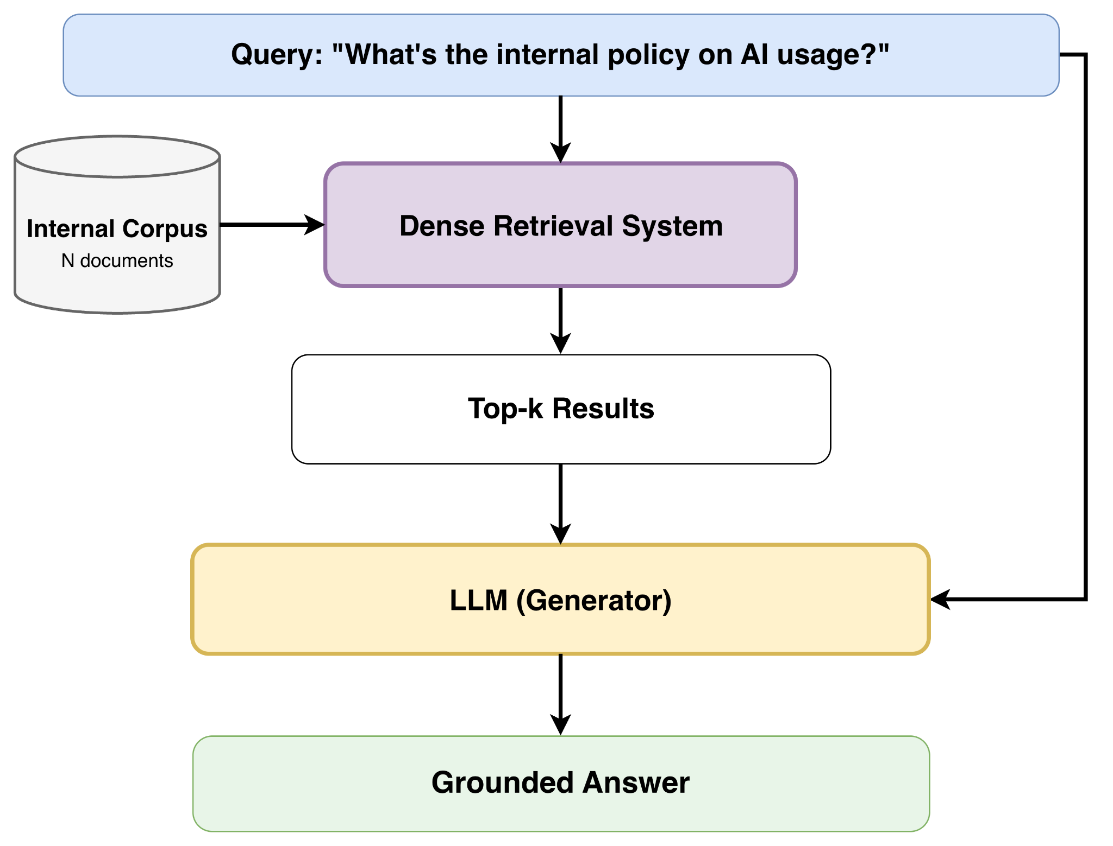
Application of Dense Retrieval System
Introduction
Retrieval-Augmented Generation
Notes:
RAG or Retrieval-Augmented Generation is one of the popular application of dense retrieval system
Here the retriever acts as LLM’s long term memory.
It pulls in relevant internal documents which is feed as context to LLM models along with the original query
Applications like these require dense retrieval system to scale a lot

Slide 9
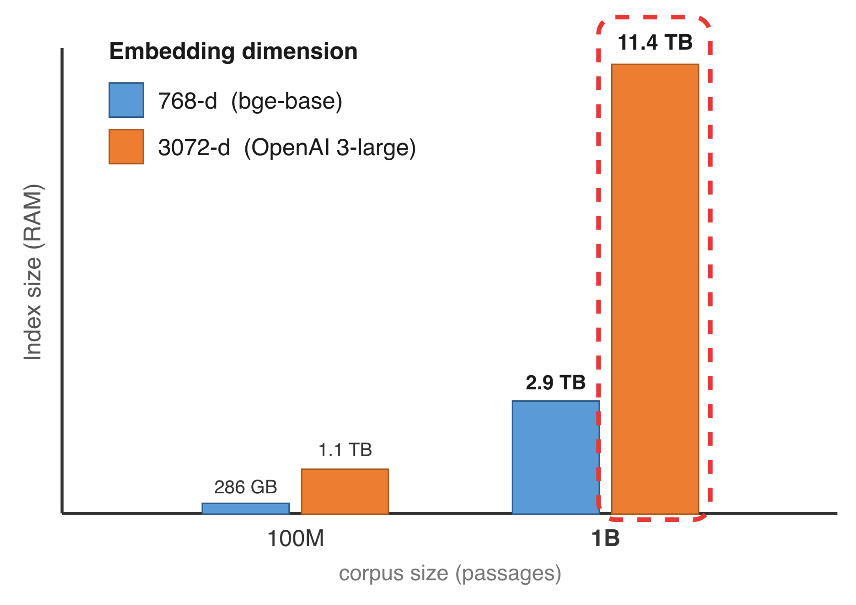
Why Embedding Compression ?
Introduction
Index Size = 32 bits * Embedding Dimension * Corpus Size
All embeddings stays in RAM
Notes:
The Core Problem: It's all about scale.
The Formula: Index Size = Corpus Size × Embedding Dimension. (Bigger models + more documents = massive indexes).
The Chart Example: Point to the orange bar on the right. A 1-billion document corpus using a top-tier model creates an 11.4 TB index.
The RAM Bottleneck: Emphasize that to keep searches fast (low latency), this must live in RAM, not SSDs. 11.4 TB of RAM is completely unmanageable.

Slide 10
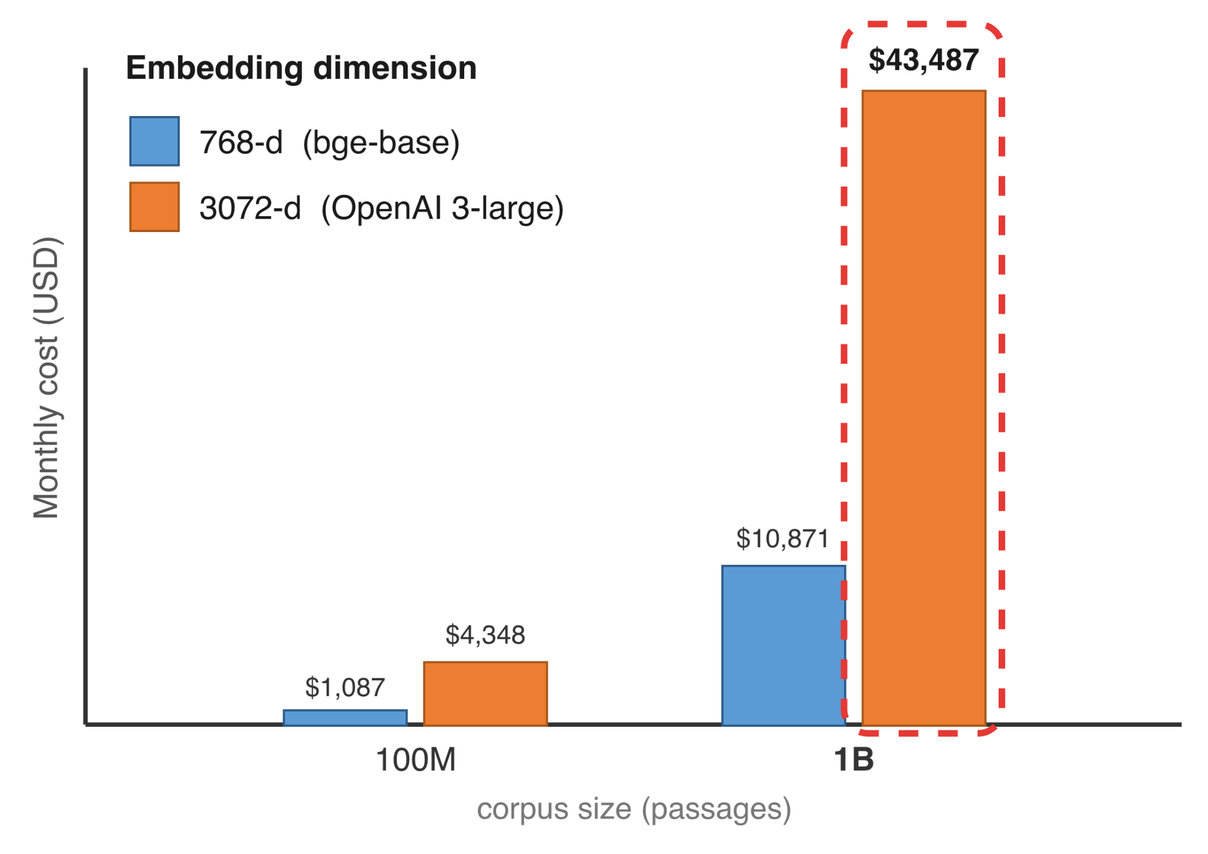
Memory is Expensive
Introduction
Memory-optimized x2gd EC2 instances cost $3.80 per GB-month
Notes:
But RAM is expensive.
The approximate cost of 1 GB memory per month in a memory optimized AWS ec2 instance is 3.8 dollar. We convert previous memory requirement to cost. We are looking at 43 thousand dollar per month to operate a retrieval system with 1B documents using openai’s embedding model.

Slide 11
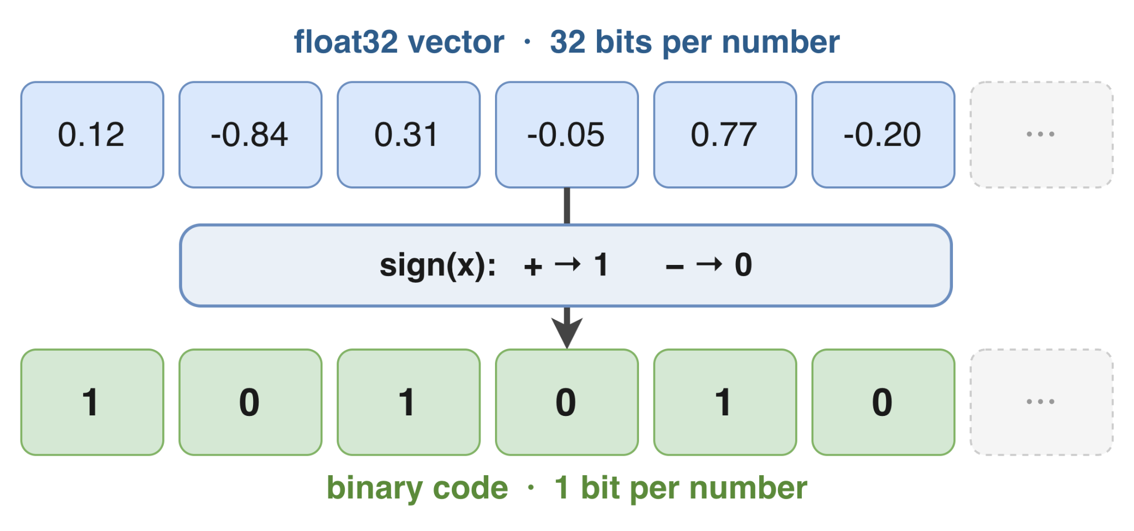
Simple Example of Embedding Compression
Introduction
Keep the sign, drop the rest (32× compression)
Binarization / Binary
Notes:
The Input: Point to the top row. These are "float32" values—32 bits per number.
The Operation: We apply the sign function.
The Logic: Positive numbers $\rightarrow$ 1. Negative numbers $\rightarrow$ 0.
The Result: Point to the bottom row. We now have a binary code.
The Payoff: We went from 32 bits to 1 bit. That is a 32x compression ratio. We keep the "sign" (the direction) and drop the "rest" (the precision).

Slide 12
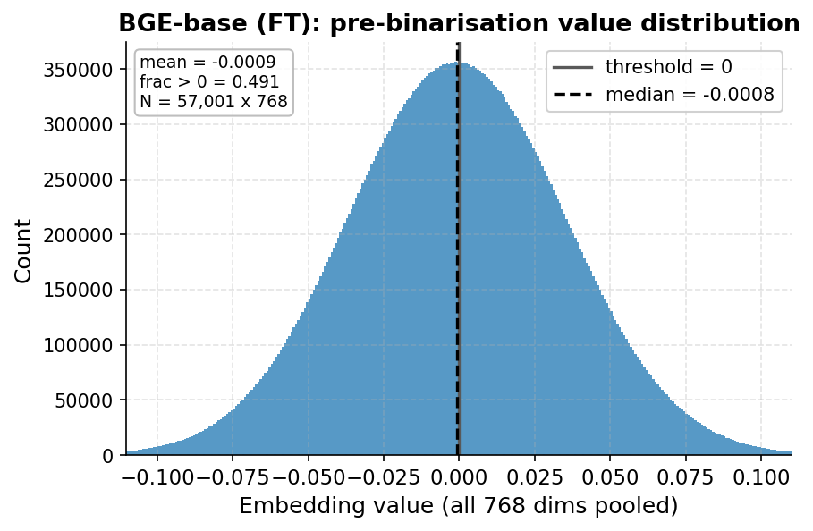
Why threshold of 0
Introduction
Notes:
The Input: Point to the top row. These are "float32" values—32 bits per number.
The Operation: We apply the sign function.
The Logic: Positive numbers $\rightarrow$ 1. Negative numbers $\rightarrow$ 0.
The Result: Point to the bottom row. We now have a binary code.
The Payoff: We went from 32 bits to 1 bit. That is a 32x compression ratio. We keep the "sign" (the direction) and drop the "rest" (the precision).

Slide 13
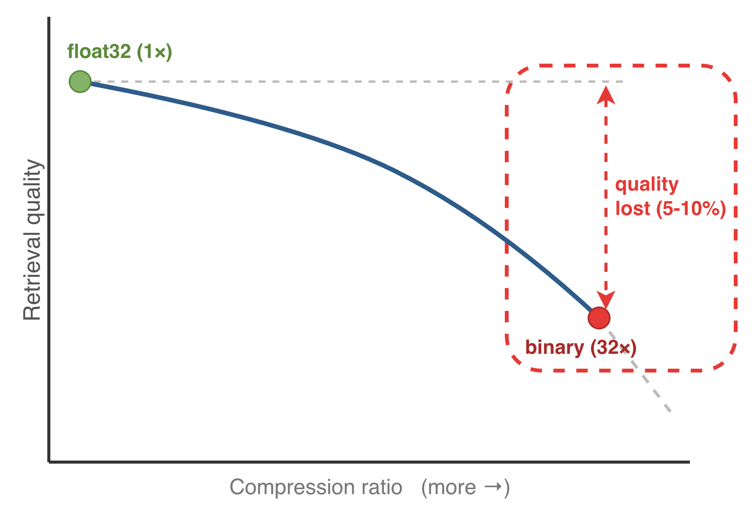
Problem with Embedding Compression
Introduction
Trade off of compression vs retrieval quality
Notes:
The Catch: Compression isn't free. Introduce the tradeoff between index size and retrieval quality.
The Graph: Point to the top left baseline (float32) and trace the line down to the compressed state (binary).
The Cost: Point to the red dashed box. Emphasize that simple binarization causes a 5 to 10% drop in performance.
The Transition: This sets up the whole thesis. The goal is to get the high compression without losing that 10% accuracy.

Slide 14
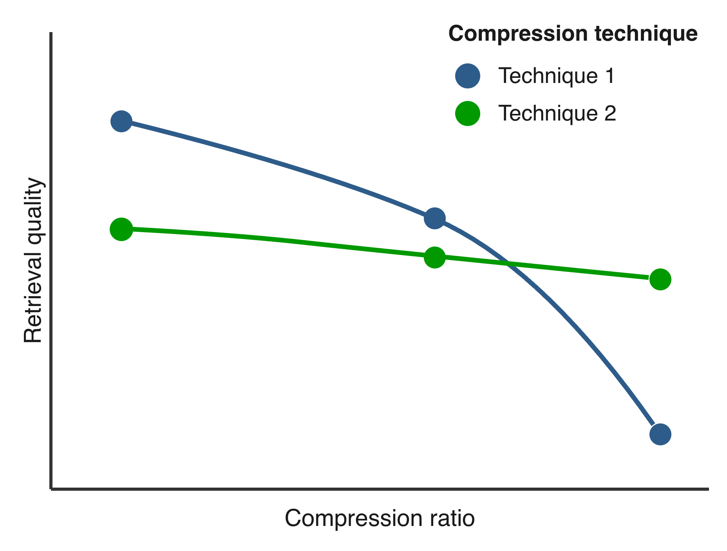
The Open Questions
Introduction
Which technique compresses the most while keeping quality?
This thesis: systematic fair comparison
Notes:
The Open Question: How do we maximize compression without losing quality? Id there any technique than can do this?
The Graph: There are 2 techniques being compared at various compression ratios. Technique 1 collapses after certain compression while technique 2 can hold its retrieval performance even at high compression.
This sets up the thesis goal very well. We try to find the answer to these question based on systematic, fair comparison across many compression technique

Slide 15
Background

Slide 16
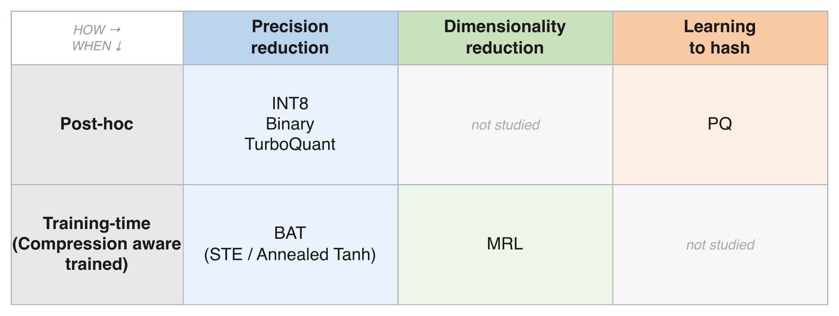
Compression Landscape
Background
Two axes: when you compress, and how
Notes:
Before diving in the different techniques we evaluated in this thesis.
Let look at how we organized the compression methods into two axis.
Axis 1: WHEN:
Post-hoc: Compressing after generation (like the 1-bit example).
Training-time: The model learns to compress during its training phase.
Axis 1: How:
Precision reduction: the bits required to store each embedding value is reduced
Dimensionality reduction: We truncated the embedding vector
Learning to hash: based on learning to create cookbooks.
We will look at each technique in brief in following slides

Slide 17
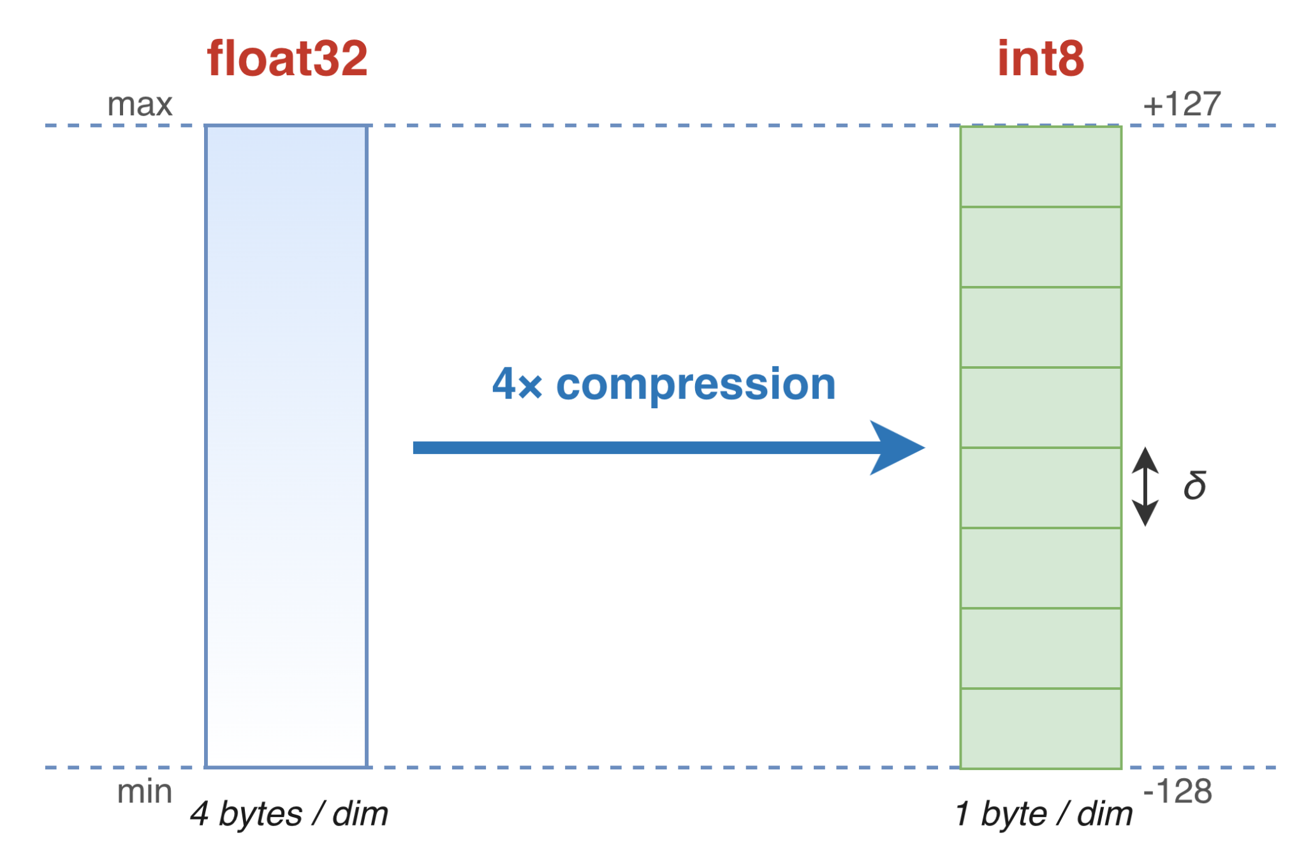
Post-Hoc Precision Reduction
Background
Binary
INT8
Near lossless
Need calibration data
Bucket range are uniform
Notes:
For Post Hoc Precision Reduction.
Binary method: Already done
INT8:
we discretize or quantize the floating 32 bit embedding values to 8 bit integer value
4x compression
almost lossless.
need the min and max values of the embedding to determine the bucket ranges.
So we use a calibration data
Here the buckets are assigned uniformly

Slide 18
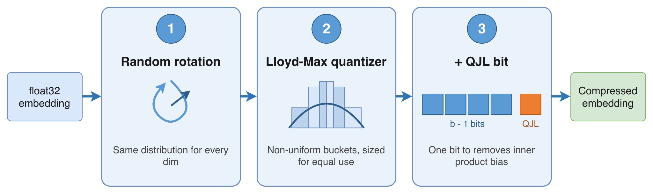
Post-Hoc Precision Reduction
Background
TurboQuant (2025)
Notes:
TurboQuant is a recent development in 2025 from google researchers.
It can be used for vector quantization with application like
KV cache compression, helping with memory requirements during inference of LLM models
Also can be used to compression embeddings for retrieval systems
It basically 3 stage process.
Random rotation
Randomly rotate each vector.
makes every embedding dimension follow the same known beta distribution
Non-uniform quantization
Each dimension is quantized into buckets.
Unlike INT8's uniform buckets, here the bucket sizes vary so that every bucket is used roughly equally.
Goal: reduce the MSE (reconstruction) bias.
Inner-product correction with QJL (Quantized Johnson–Lindenstrauss)
Embeddings are compared by cosine / inner product
minimizing MSE isn't enough
QJL

Slide 19
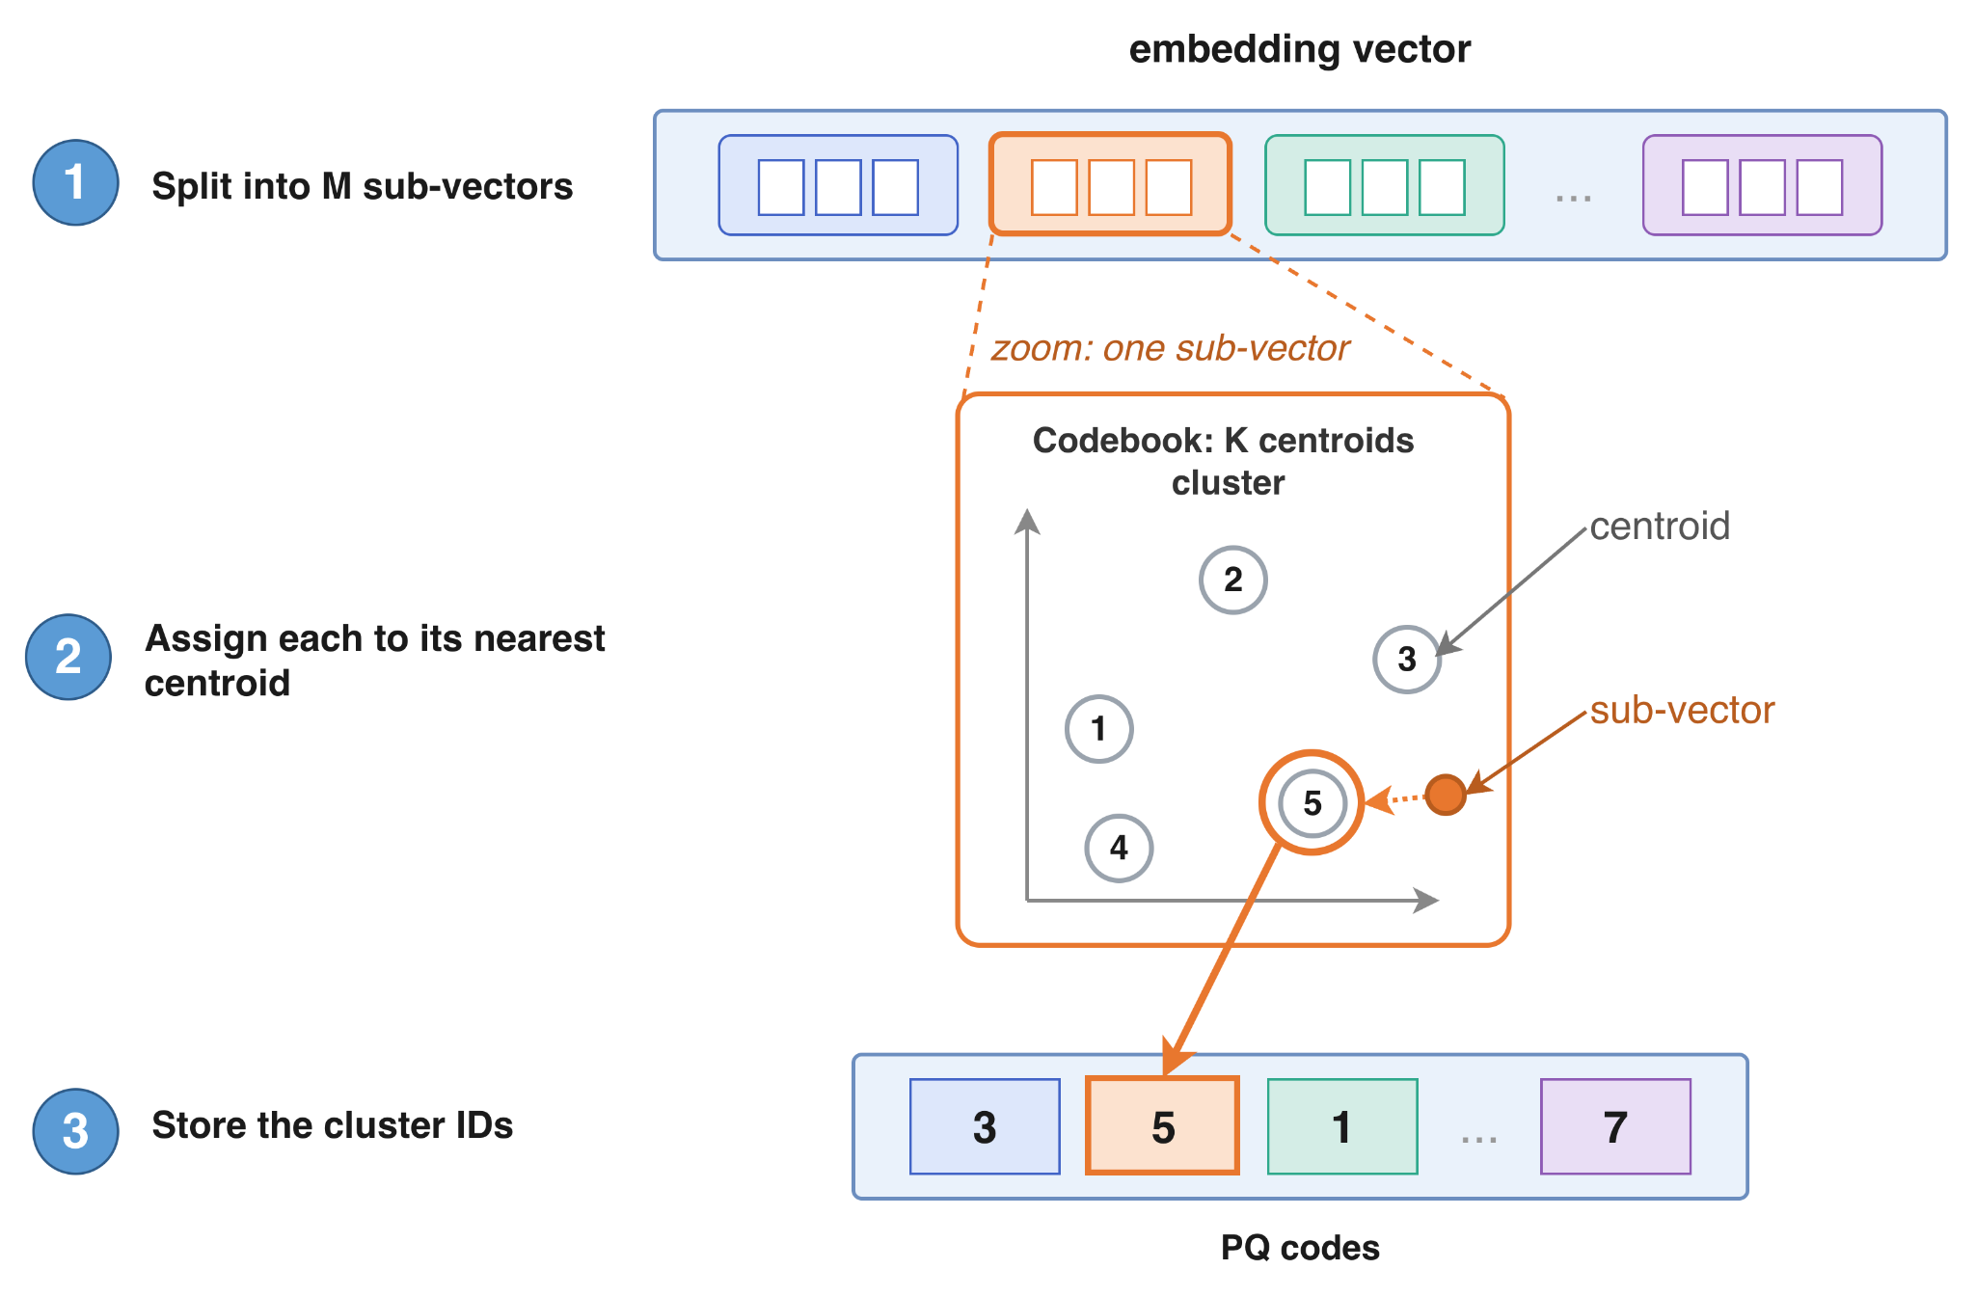
Post-Hoc Learning to Hash
Background
Product Quantization (PQ)
Size = M × log2(K) bits
Notes:
In Product Quantization,
Split the vector: split the entire embedding vector to M sub vectors.
Assign nearest centroid:
Each sub vector uses its corresponding cookbook.
The cookbook is a cluster with K centroids
This is trained with embedding of training data.
find the nearest cluster to the sub vector
Encode by nearest centroid
store the cluster ID instead of sub vector
The index size for PQ: given by the formula shown in the slide
Determined by two knobs:
M — how many sub-vectors we split into.
K — how many centroids per codebook.

Slide 20
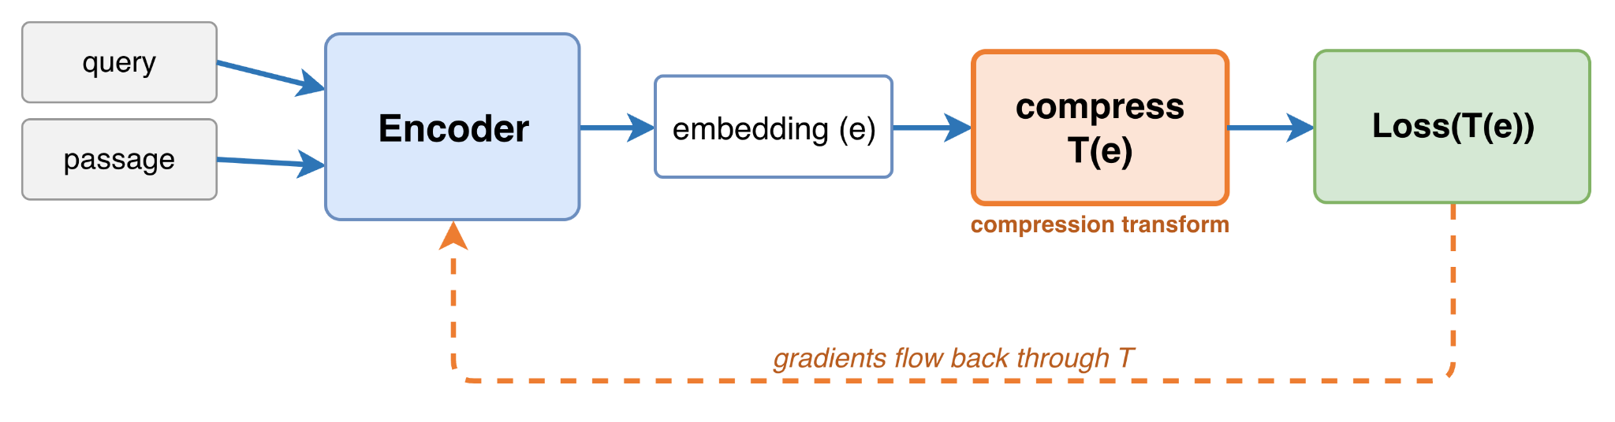
Compression Aware Training
Background
Bake the compression into the loss
Notes:
Until now, we were discussing compression technique where the encoder model was quite unaware that its embeddings were compressed.
In Compression-aware training, encoder is made aware of the embedding compression.
We apply the compression transform during training process itself.
This way the gradients flow through the compression transform itself, making the encoder weights aware of the compression.

Slide 21
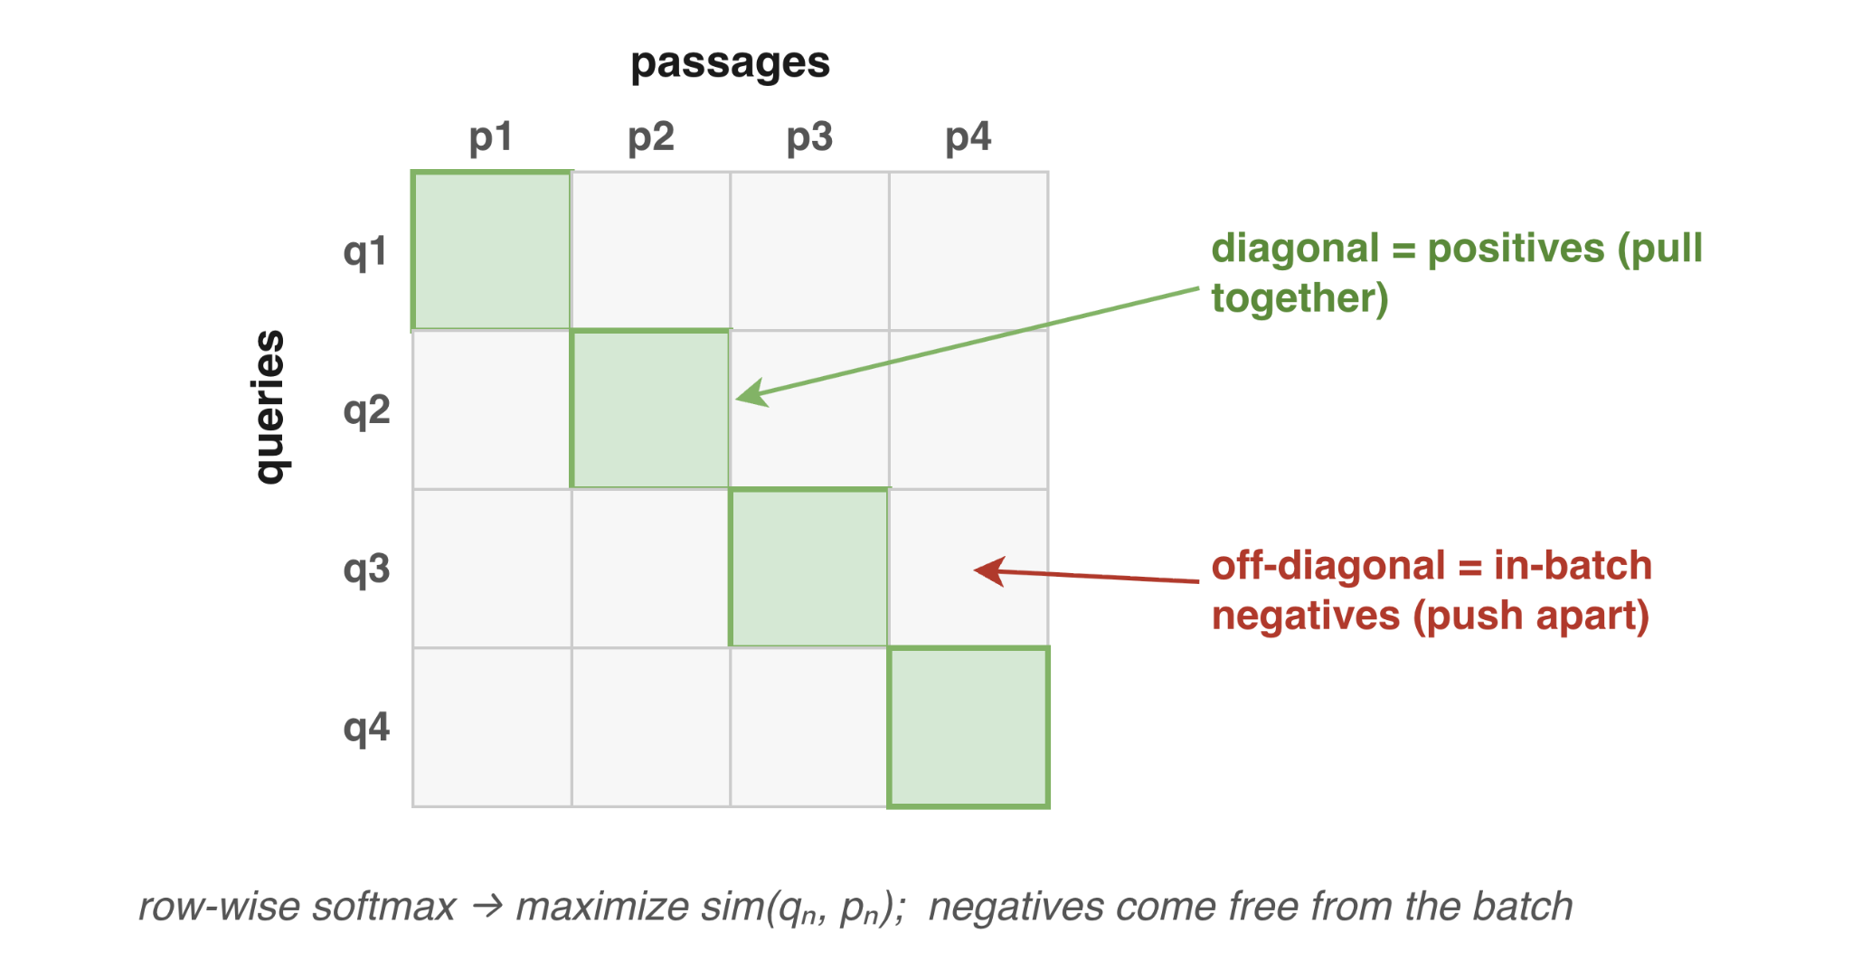
Multiple Negative Ranking Loss (MNRL)
Background
Pull the true pair together, push the rest apart
Notes:
For training retrieval model, MNRL loss is a standard loss function.
The dataset will have many data points.
Let assume that we take 4 data points in a batch, just like in the figure.
Which means we will have 4 query and 4 passage arranged in a matrix.
The diagonal represents the relevant query and passage pair which are called positive pairs.
MNRL loss tries to pull the embeddings of such pairs together
Any other pair of query and passage are called negatives and we troy to push their embeddings away

Slide 22
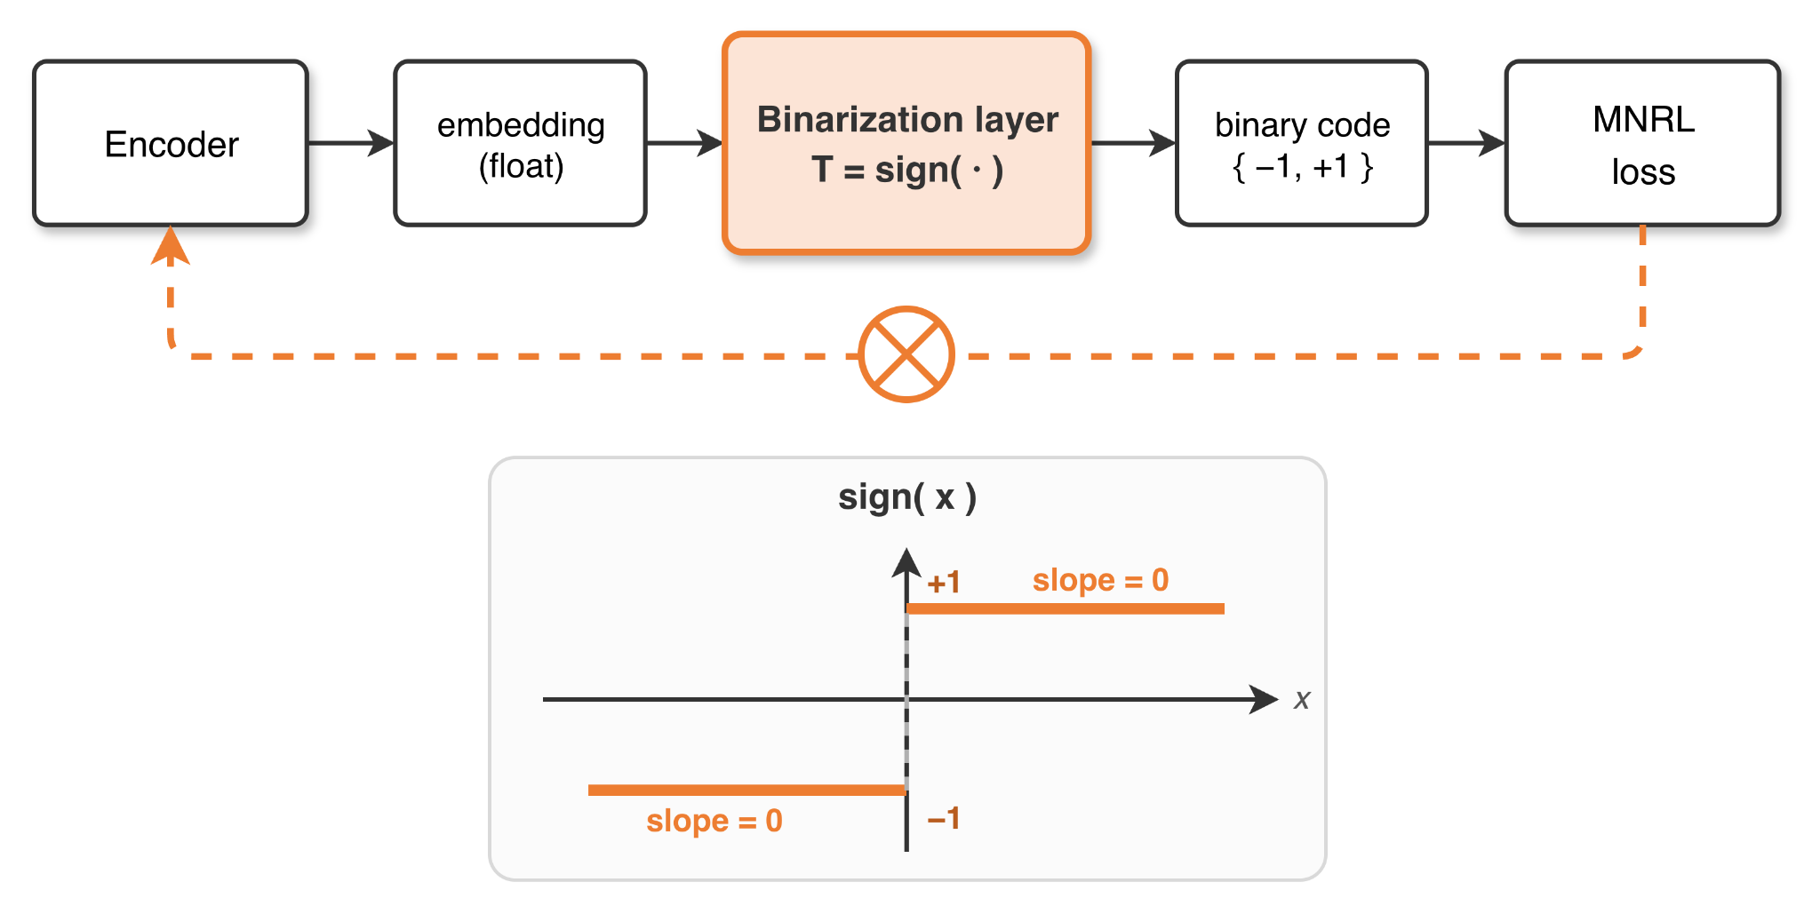
Binarization Aware Training (BAT)
Background
sign() is not differentiable at x = 0, and its gradient is zero everywhere else.
Notes:
Binarization Aware training is a training time compression technique.
We add a binarization layer, changing the arch of the retrieval model.
This layer uses the same sign function we saw at post hoc binary technique.
We compute the loss using this new binary embeddings and try to backpropagate.
But sign is not differentiable at x = 0, and slope is zero everywhere else.
We try to solve this by approximating the gradients in 2 ways

Slide 23
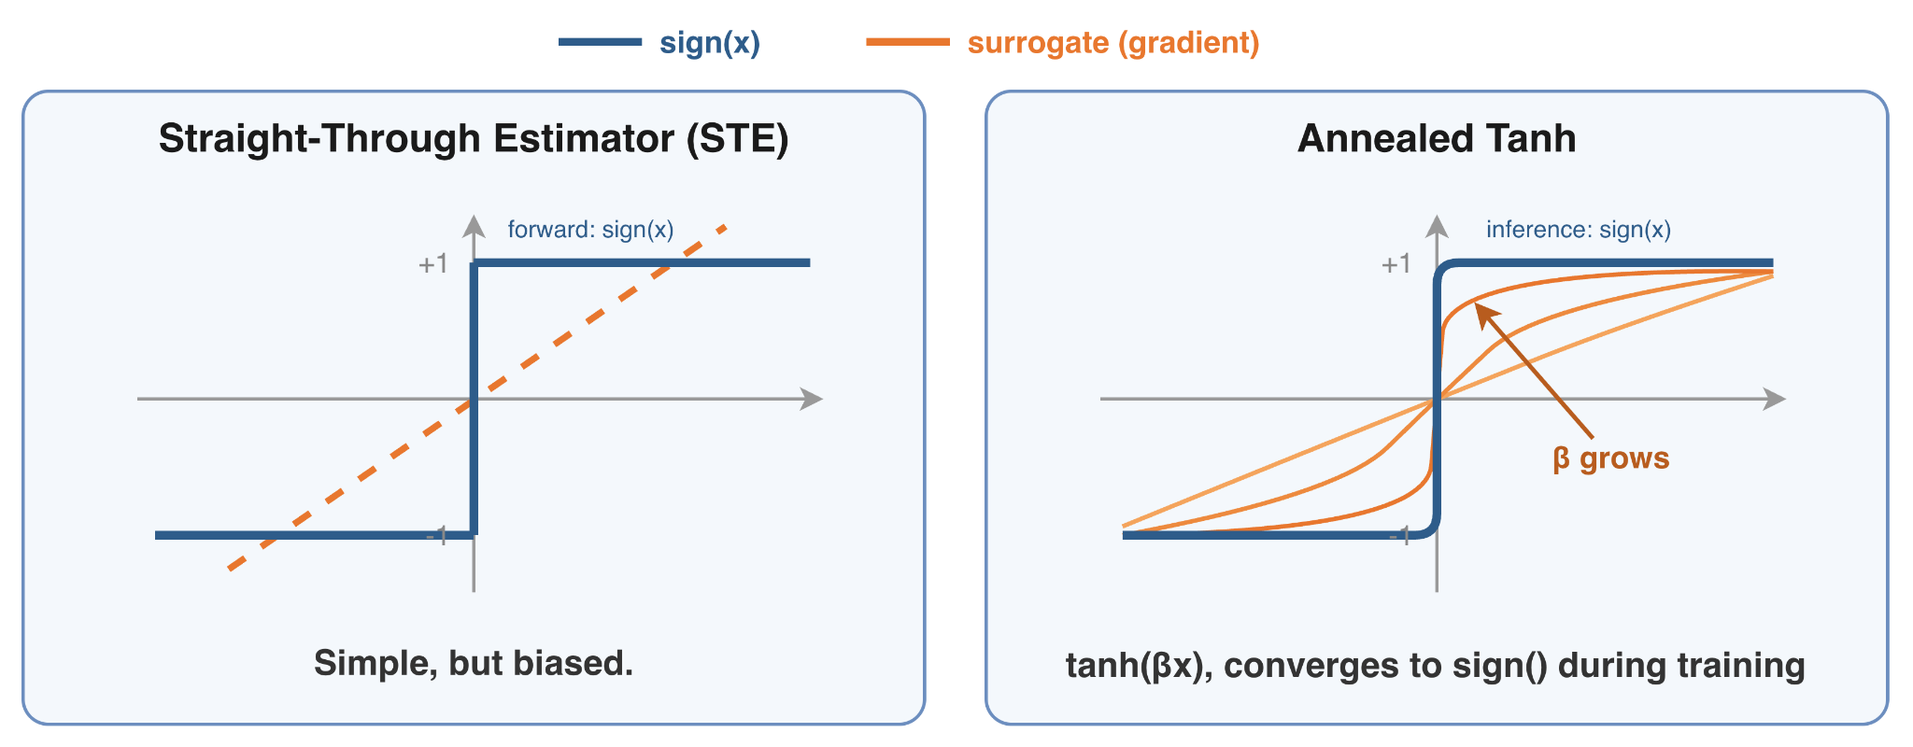
Gradients Approximation: STE vs Annealed Tanh
Background
Two ways to get a usable gradient through sign()
Notes:
The two surrogate gradients are STE and annealed tanh
In STE
Forward pass: use the real sign function (true binary output).
Backward pass: we assume gradient is identity as shown in figure. So, gradients pass straight through it
Annealed tanh fixes this bias
it uses tanh instead of sign function.
This function is differentiable.
We have a temperature parameter beta that grows as we train the model
As beta grows, tanh converges to sign function
During inference we switch to sign function

Slide 24
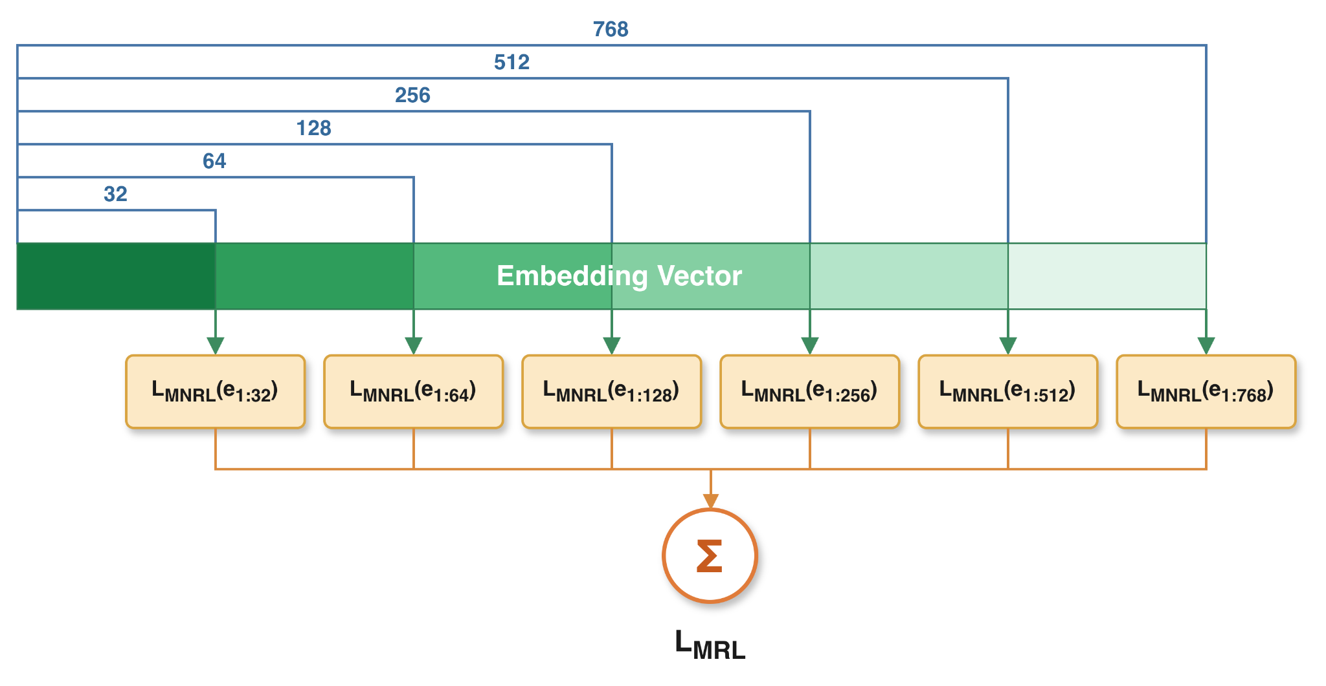
Matryoshka Representation Learning (MRL)
Background
One model trained at many embedding truncation at once
Notes:
MRL is another popular train time method.
The idea is to Push the important information toward the front of the vector, and the less important nuance toward the back.
It allows flexible vector truncation at inference time
During training the embedding vector is truncated in different lengths.
We compute the mnrl loss for each truncation and the final loss is the sum of these losses.

Slide 25
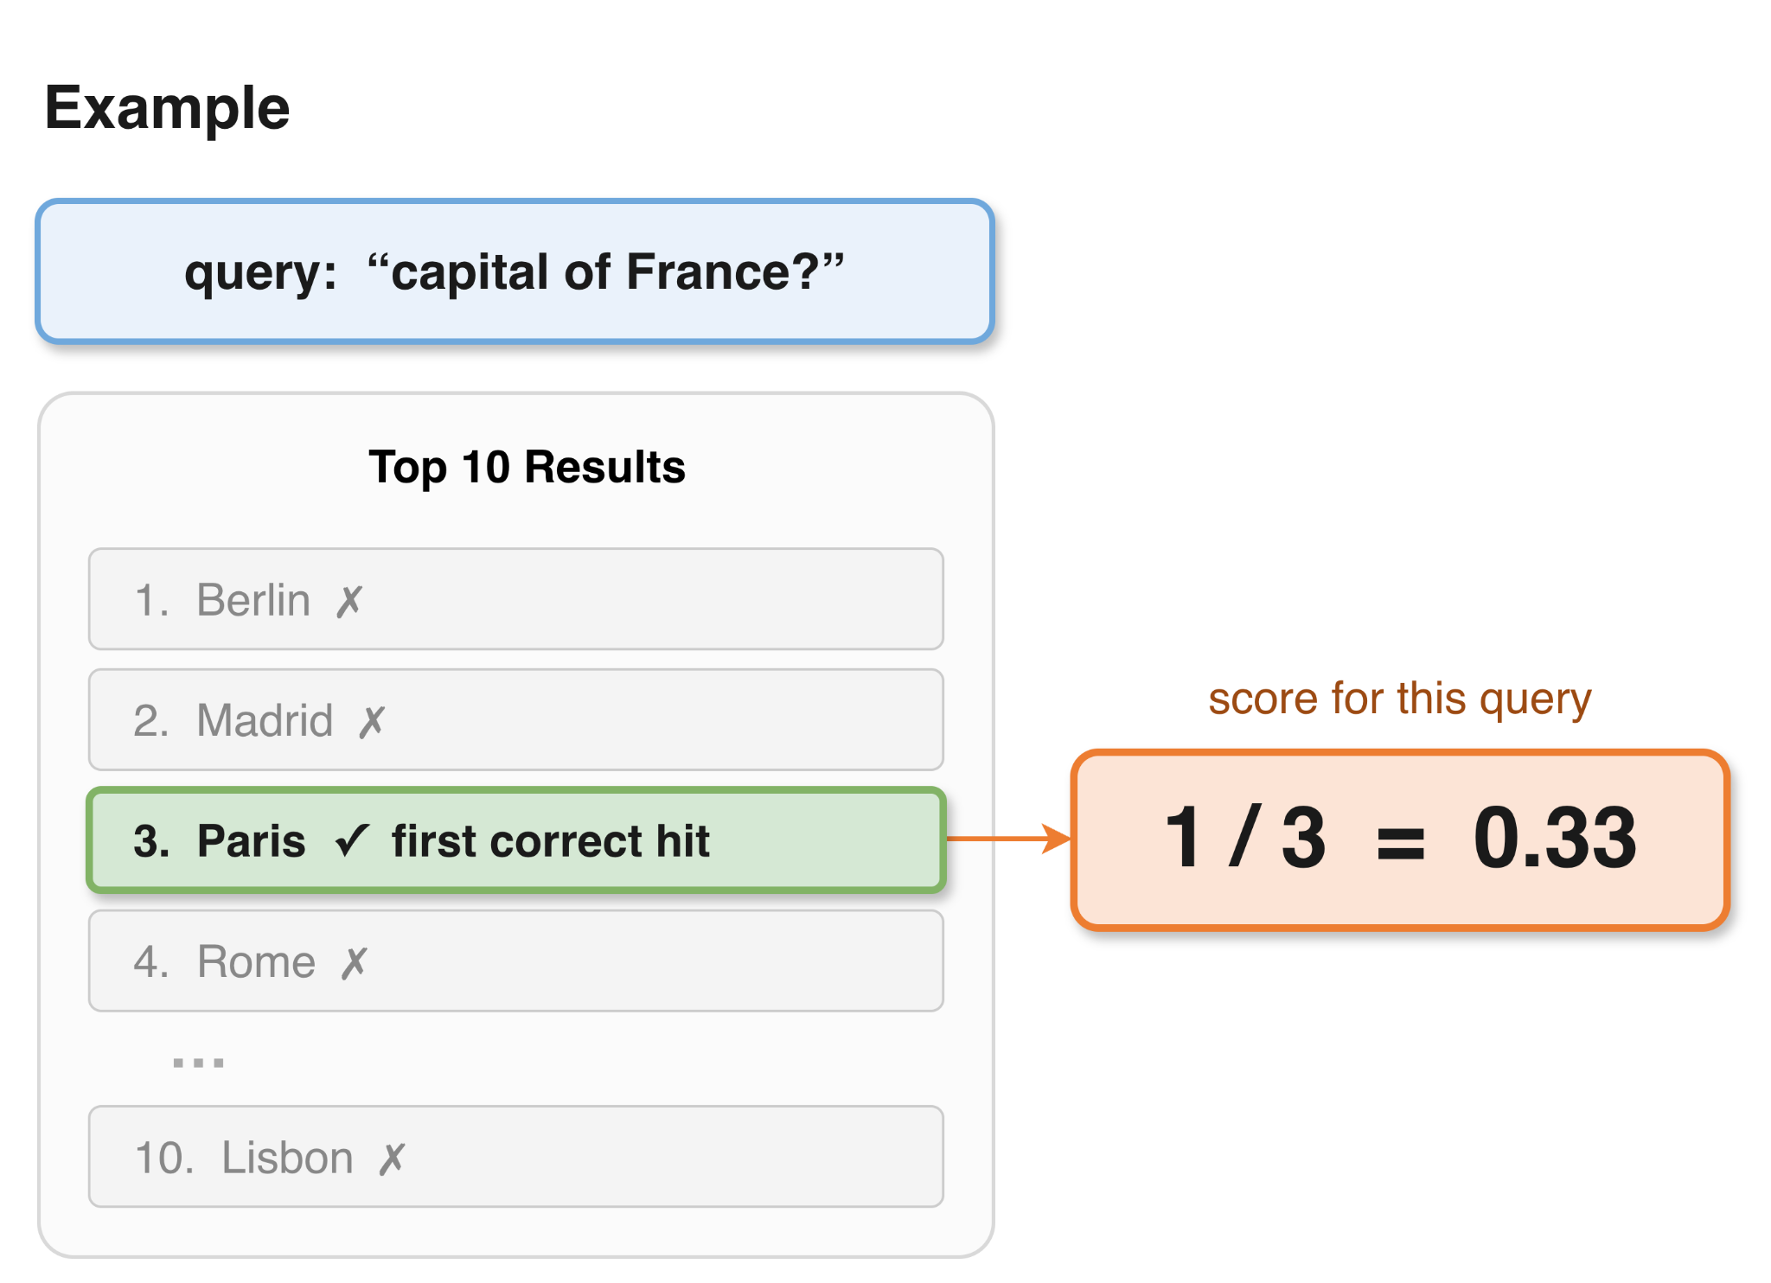
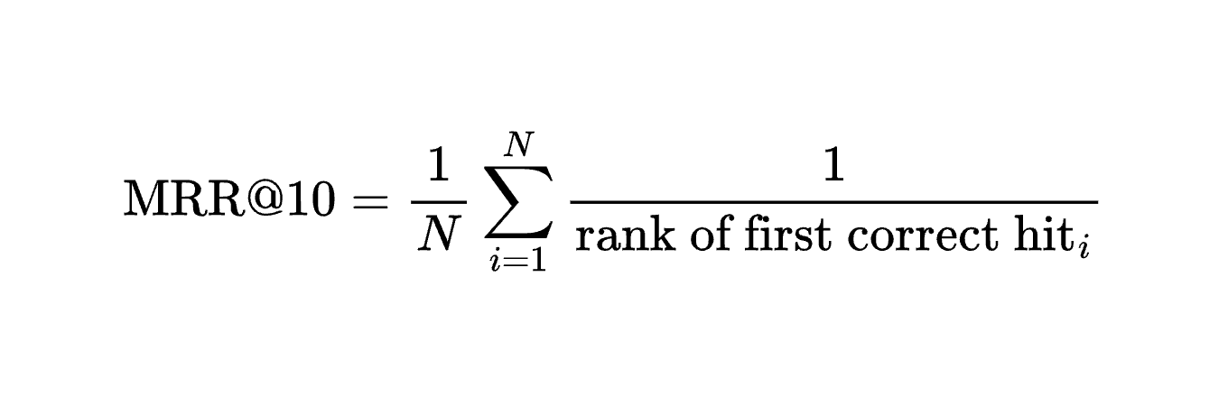
Retrieval Quality Metrics
Background
Mean Reciprocal Rank (MRR) @10 as primary metric
MRR@10: how high is the first correct hit in top 10 results?
Notes:
We use MRR@10 (Mean Reciprocal Rank) as the primary metric.
There are other metrics like NDCG and Recall, but we chose MRR because it's easy to interpret.
In the example provided, ther user query about the capital of france.
The retriever will get us the ranked list of results.
Since we are measuring MRR@10, we need to truncated the top 10 results first.
Then we try to find the correct answer. In this case, its at rank 3. So the MRR for this casae if 0.33.
This MRR is for a query. In our cases we would have hundreds of query in the benchmark and we need to aggregate them.

Slide 26
Related Works
Notes:
Let's look at some prior work that are related to our thesis

Slide 27
Related Works
Related Works
CoRECT - Controlled Retrieval Evaluation of Compression Techniques (2026)
Closest prior work in evaluation
Compares retrieval performance vs Corpus Size & Compression Ratios
Largest controlled study: 4 models × 8+ methods
Gap: post-hoc methods only, no training-time
QAMA - Quantization-Aware Matryoshka Adaptation (CIKM 2025)
Closest prior work in method
Stacks MRL with multibit quantization-aware training
Learnable thresholds
Hybrid precision: 2-bit early dims → 0.5-bit late (~1.6 bit/dim)
Gap: no tanh
Notes:
CoRECT is a recently released paper which is very close to what we are doing in our thesis
runs a controlled evaluation of retrieval performance across different compression techniques, as corpus size and compression ratio increase
One of the largest controlled studies of its kind: 4 backbones × 8+ compression techniques
Gap: its focus is post-hoc methods only
QAMA is another paper introducing a stacked train time compression method.
Combines MRL with multibit quantization aware training.
For multi-bit quantization, it needs multiple thresholds
It makes them learnable
It uses hybrid precision
Early dimensions: 2-bit;
latest dimensions: 0.5-bit
Gap: it does not use the annealed-tanh approach for quantization-aware training.

Slide 28
Related Works
Related Works
BPR — Binary Passage Retriever (Yamada et al., ACL 2021)
Compares retrieval of annealed tanh with PQ and full precision
Shows annealed tanh better than PQ
Gap: tanh only, never compared with STE
BEBR — Binary Embedding-based Retrieval at Tencent (Gan et al., KDD 2023)
Uses recurrent residual binarization for multibit compression
Has runtime flexible bit depth
Task/model-agnostic
Trained separate from encoder (Not end to end training pipeline)
Gap: STE based only; different model, benchmark
Notes:
In the Binary Passage Retriever paper,
Uses annealed tanh for the retrieval task.
Compares its binary embeddings against full precision and PQ.
Result: the tanh method beats PQ.
Gap: it never compares tanh against the STE variant
For, Binary embedding based retrieval at tencent paper,
Uses a recurrent residual binarization method for multi-bit compression.
Each additional bit covers the residual error left by the previous bits.
Gives the user runtime flexibility over bit depth (similar to how MRL gives runtime dimension truncation flexibility)
Task- and model-agnostic: it is not an end-to-end pipeline
Which means a separate network is trained on top of frozen embeddings.
Gap: its quantization is STE-based only, and it uses a different model and a different benchmark from the rest of the related work (not a standard IR benchmark)

Slide 29
Related Works
Related Works
INDUS-SDE (Pantha et al., KDD 2026) - our prior work
Focuses on establishing new encoder model for scientific applications
Post-hoc Binary vs Binary Aware Training (BAT-STE)
Demonstrates BAT-STE better than Post-hoc Binary
Gap: single model, single domain benchmark, uses only STE
Notes:
Finally, we have our INDUS-SDE paper.
It was recently accepted for KDD 2026. The conference is yet to happen.
I with my team lead co authored this papers and completed it with the help of several teammates
The paper's main focus is establishing a new encoder model for scientific applications.
But it has one section directly relevant here: we compare post-hoc binary vs. Binarization Aware Training (BAT-STE).
We demonstrated BAT-STE outperforms post-hoc binary.
Main gap are that it was tested on only one model (INDUS-SDE) using only one domain-specific benchmark (scientific)
And we experimented with only STE

Slide 30
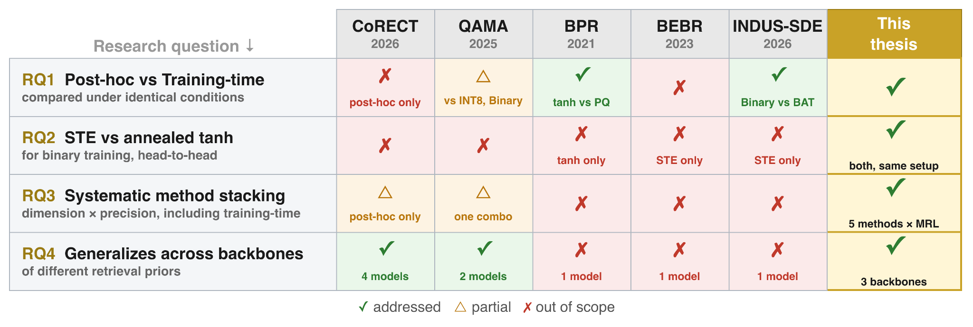
Research Gap Matrix
Related Works
Notes:
Finally, this is the summary of gap we found in the related works.
This also sets up the research question for the thesis
RQ1 — Post-hoc vs. training-time, under identical conditions
CoRECT: has the comparisons, but post-hoc methods only → ✗.
QAMA: stacks MRL with multi-bit quantization, compared against INT8 and binary — but at different compression ratios, so it's not an identical-conditions comparison → △ (partial).
BPR: compares tanh vs. PQ at 32× compression, so technically it does satisfy this condition → ✓.
INDUS-SDE: compares post-hoc binary vs. BAT → ✓.
RQ2 — STE vs. annealed tanh, head-to-head
No prior work compares these two directly.
This thesis runs both, in the same setup → ✓.
RQ3 — Systematic method stacking
CoRECT: does stack methods (e.g., MRL + PQ, MRL + Binary), but post-hoc only → △.
QAMA: stacks MRL with quantization, but only one combination → △.
This thesis: 5 methods × MRL, systematically → ✓.
RQ4 — Generalizes across backbones
We check whether retrieval performance holds across different backbones.
CoRECT: 4 models ✓ ·
QAMA: 2 models ✓ ·
BPR / BEBR / INDUS-SDE: 1 model each ✗.
This thesis: 3 backbones → ✓.

Slide 31
Methodology
Notes:
Let move forward with methodology

Slide 32
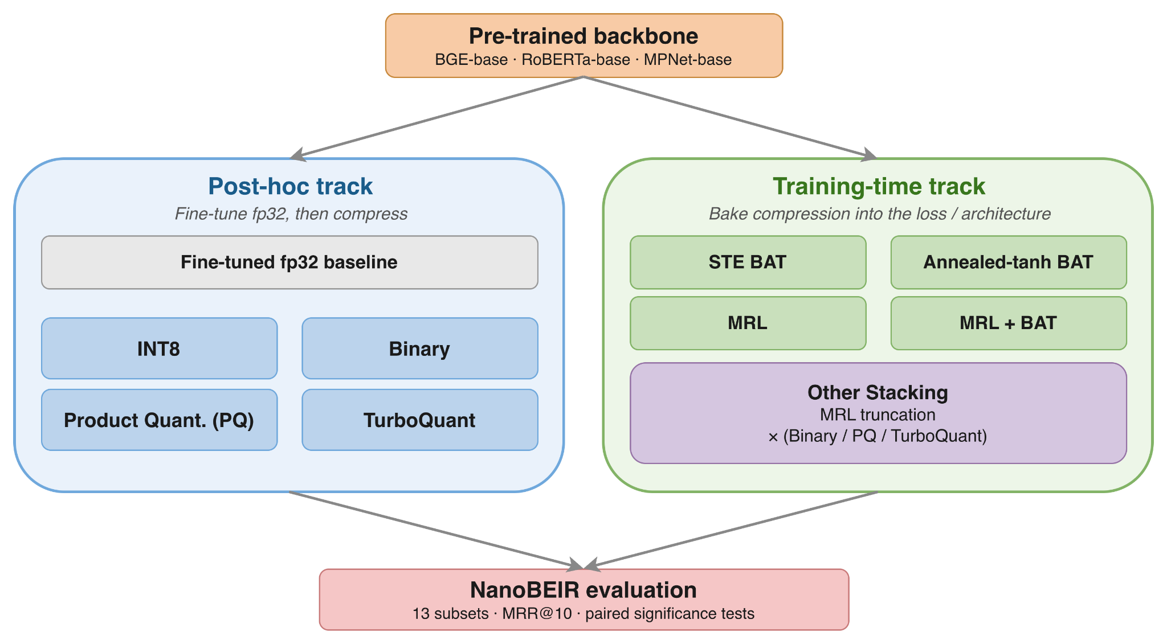
Experimental Design
Methodology
Fair comparison: Same backbone, Same data, Same benchmark
Notes:
This block diagram shows the experimental design used in the thesis, built around the idea of fair comparison.
Every method is compared under the same backbone, same training data, and same benchmark.
Starting point
start from one of three pre-trained backbones: BGE-base, RoBERTa-base, or MPNet-base.
Two tracks we can follow
Post-hoc track:
first fine-tune the backbone to get an fp32 baseline, which produces float32 embeddings.
Those embeddings are then compressed with various post-hoc methods (INT8, Binary, PQ, TurboQuant).
Training-time track:
instead of compressing afterward, we bake the compression into the loss or architecture and train it directly from the backbone.
We can also stack multiple techniques here.
Shared evaluation
Both tracks feed into the same NanoBEIR evaluation: 13 subsets,
scored with MRR@10.
We also run paired significance tests to check whether score differences are statistically significant, not noise.

Slide 33
Setup: Backbone Models
Methodology
BGE-base-en-v1.5 (Primary)
109M parameters
Pre-training: MLM + contrastive retrieval
Strongest retrieval prior
RoBERTa-base (Secondary)
125M parameters
Pre-training: token-level MLM only
Weakest initial retrieval geometry
MPNet-base (Secondary)
110M parameters
Pre-training: masked + permuted LM
Middle-ground retrieval quality
All produce 768-dim float32 embeddings
Backbone quality ordering: BGE > MPNet > RoBERTa
Notes:
This block diagram shows the experimental design used in the thesis, built around the idea of fair comparison.
Every method is compared under the same backbone, same training data, and same benchmark.
Starting point
start from one of three pre-trained backbones: BGE-base, RoBERTa-base, or MPNet-base.
Two tracks we can follow
Post-hoc track:
first fine-tune the backbone to get an fp32 baseline, which produces float32 embeddings.
Those embeddings are then compressed with various post-hoc methods (INT8, Binary, PQ, TurboQuant).
Training-time track:
instead of compressing afterward, we bake the compression into the loss or architecture and train it directly from the backbone.
We can also stack multiple techniques here.
Shared evaluation
Both tracks feed into the same NanoBEIR evaluation: 13 subsets,
scored with MRR@10.
We also run paired significance tests to check whether score differences are statistically significant, not noise.

Slide 34
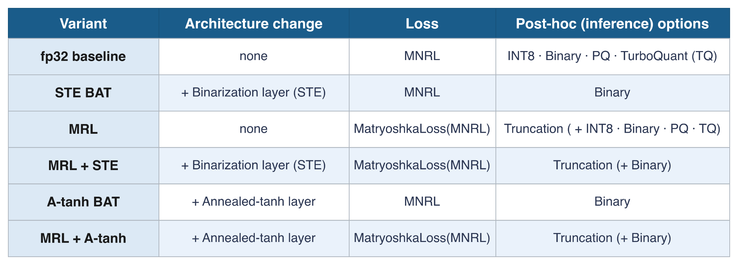
Six Training Variants and Their Combinations
Methodology
3 backbones × 6 training varients × {INT8 · Binary · PQ · TQ} × truncation {32…768} = 226 configs
Notes:
The experimental setup can introduce many configuration that can be evaluated independently.
With 3 backbones, 6 training variants, 4 post hoc options and truncation: we have evaluated different 226 configurations in this thesis.
Walking the six variants
fp32 baseline — no architecture change, standard MNRL loss. And we have 4 post-hoc options
STE BAT — change in arch adding a binarization layer (STE), MNRL loss. Inference is Binary only.
MRL — no architecture change, but loss becomes MatryoshkaLoss. Post-hoc options are truncation, and on top we can stack with other methods
MRL + STE — our first stacked training-time method: changes both architecture (STE binarization) and loss (Matryoshka). At Inference: truncation and on top we can binarize.
A-tanh BAT — same idea as STE BAT, but swaps the binarization layer for the annealed-tanh layer.
MRL + A-tanh — the annealed-tanh equivalent of MRL + STE: annealed-tanh layer with Matryoshka loss.

Slide 35
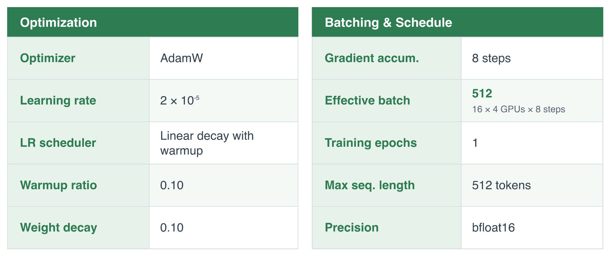
Training Hyperparameter
Methodology
One hyperparameter, shared across all 6 variants and all 3 backbones
Notes:
These are the shared identical hyperparameters we used to train all the 6 variants for all backbones.
We used AdamW with starting learning rate of 2x10^-6, which is typical lr.
The LR is scheduled to delay linearly with a warmup of 0.1 and weight decay of 0.1
Our per GPU batch size is 16, we have 4 gpus and 8 accumulation steps. That makes the effective batch size of 512.
We trained all variants for 1 epoch
The max sequence length was set at 512 token and precision used for training was bf16.

Slide 36
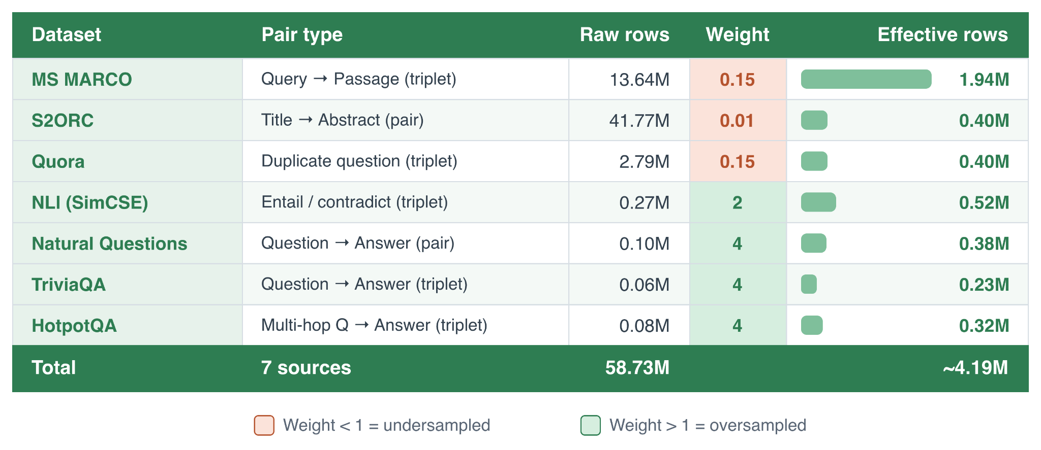
Training Dataset
Methodology
7 public sources; weighted sampling to rebalance the mixture
Notes:
This slide presents the training dataset.
We used 7 public dataset.
The pairs come in several forms:
query → passage,
title → abstract from the science domain ,
duplicate questions ,
question → answer .
Weighted sampling to rebalance the mixture
Raw sources are very uneven in size
So we apply per source weighting to rebalance them
Weight < 1: represents undersampling
Weight > 1: represents oversampling
This turns 58.73M raw rows into a balanced ~4.19M effective training rows

Slide 37
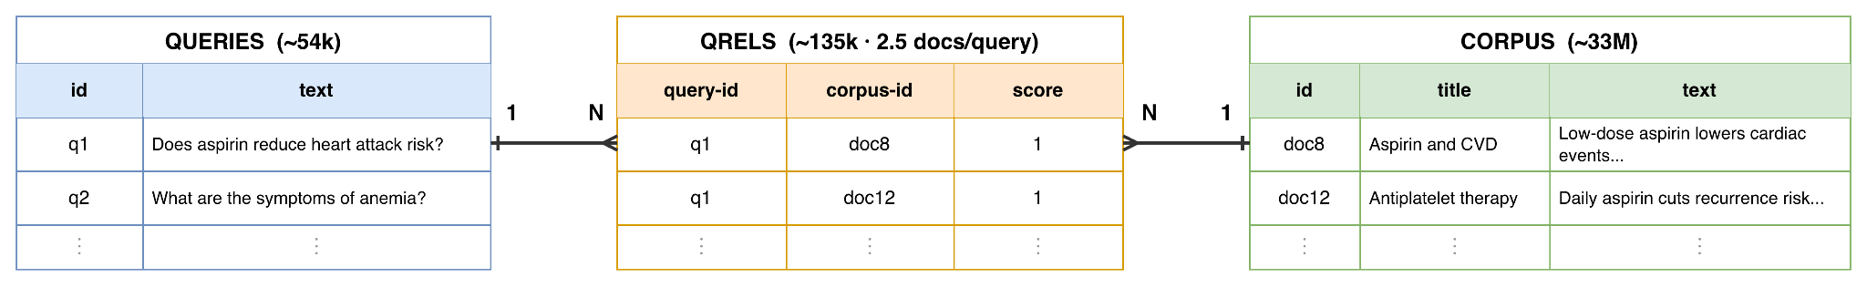
Evaluation Benchmark: What BEIR Looks Like
Methodology
Benchmark for Information Retrieval (BEIR)
15+ dataset across diverse domains
Pair of Task: QA, fact-checking, scientific, financial, argument, duplicate
Notes:
We evaluate using NanoBEIR, derived from BEIR
First, let's see what BEIR looks like
What BEIR is
Popular benchmark for Information Retrieval
15+ datasets, many domains and task types
Tasks: QA, fact-checking, scientific, financial, argument, duplicate-question
The 3 components
Every dataset has the same 3 parts
Queries: List of query texts, each with an id
Corpus: List of documents to search, each with id + text
Qrels: links a query to its relevant document by id
The relationship
One query → many relevant docs
One doc → relevant to many queries
So: many-to-many, captured by Qrels
Bridge to NanoBEIR
BEIR corpus ≈ 33M docs → slow to encode
So we use NanoBEIR: same structure, runs fast

Slide 38
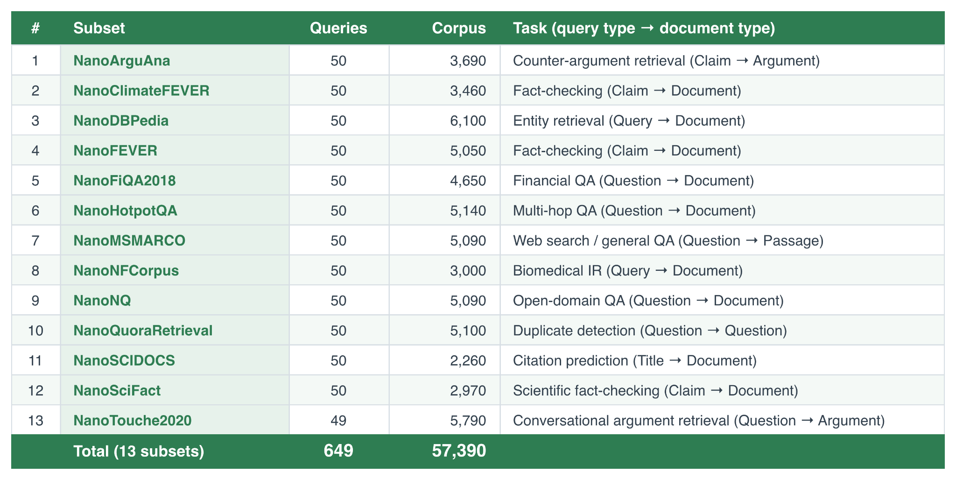
Evaluation Benchmark: NanoBEIR
Methodology
An efficient proxy for full BEIR: 13 subsets, 649 queries, 57,390 corpus
Notes:
This slides shows the distribution of the NanoBEIR which was used as evaluation.
NanoBEIR is a smaller subset of the full BEIR benchmark
NanoBEIR keeps the same diversity (uses same subset)
The composition
13 subsets, each covering a different retrieval task and domain
Each subset has 50 queries and roughly a 3k–6k document corpus.
In total: 649 queries and a 57,390-document corpus.

Slide 39
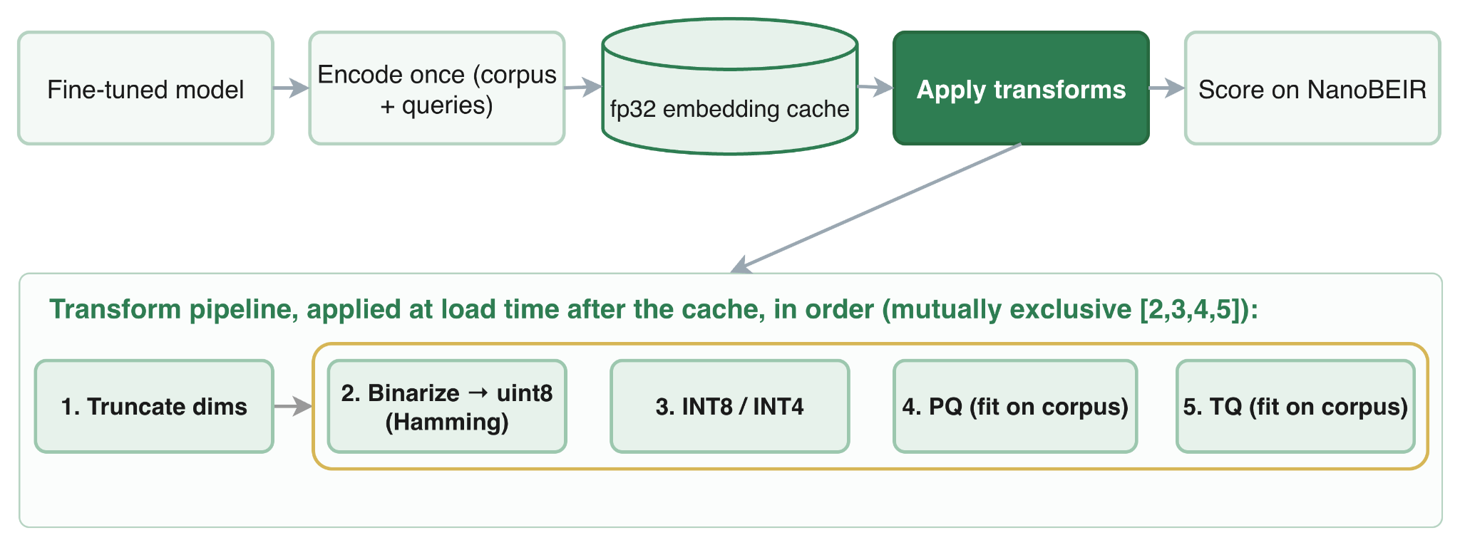
Embedding Cache & Transform Pipeline
Methodology

Slide 40
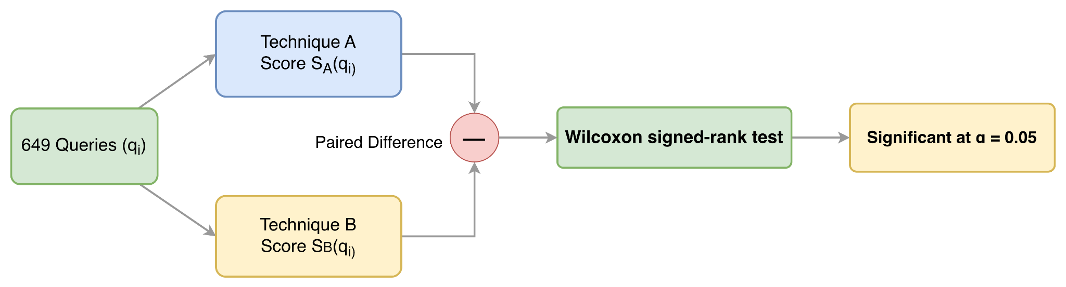
Significance Testing
Methodology
Is a difference between two methods real, or just noise?
Notes:
We also used significance test to determine if the difference in metrics is just a noise or a real difference.
The procedure
For each 649 queries, we compute score for both technique A and B.
We then find the difference of the scores
We test if the difference of score is normally distributed or not
In most cases the distribution is not normal
So we mostly use Wilcoxon test which is non parametric test
The score difference is statistically significant at alpha of 5% (lower than 5% is considered real difference)

Slide 41
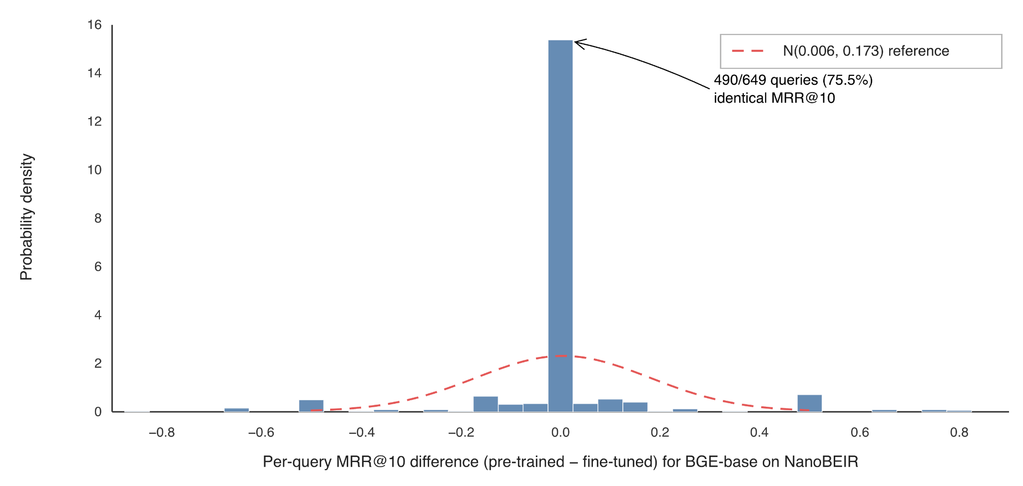
Why Wilcoxon? The Difference Distribution
Methodology
Most difference distribution is not normal

Slide 42
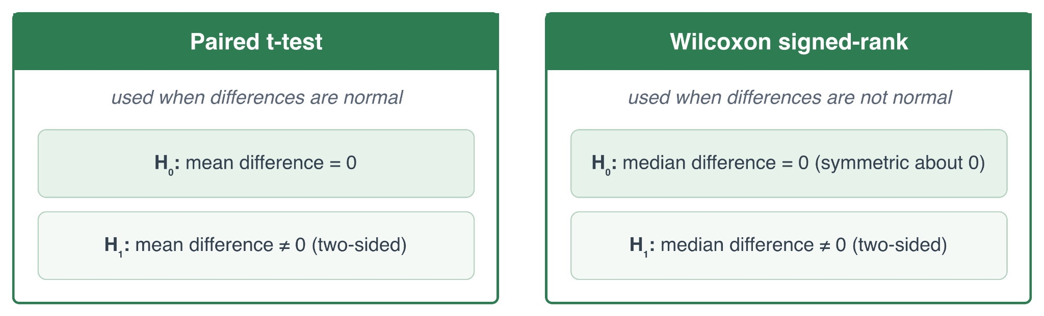
Hypotheses & Decision Rule
Methodology
Decision: reject H₀ if p < α = 0.05 → the difference is statistically significant

Slide 43
Result & Findings
Notes:
Now, let's look at the results of this thesis

Slide 44
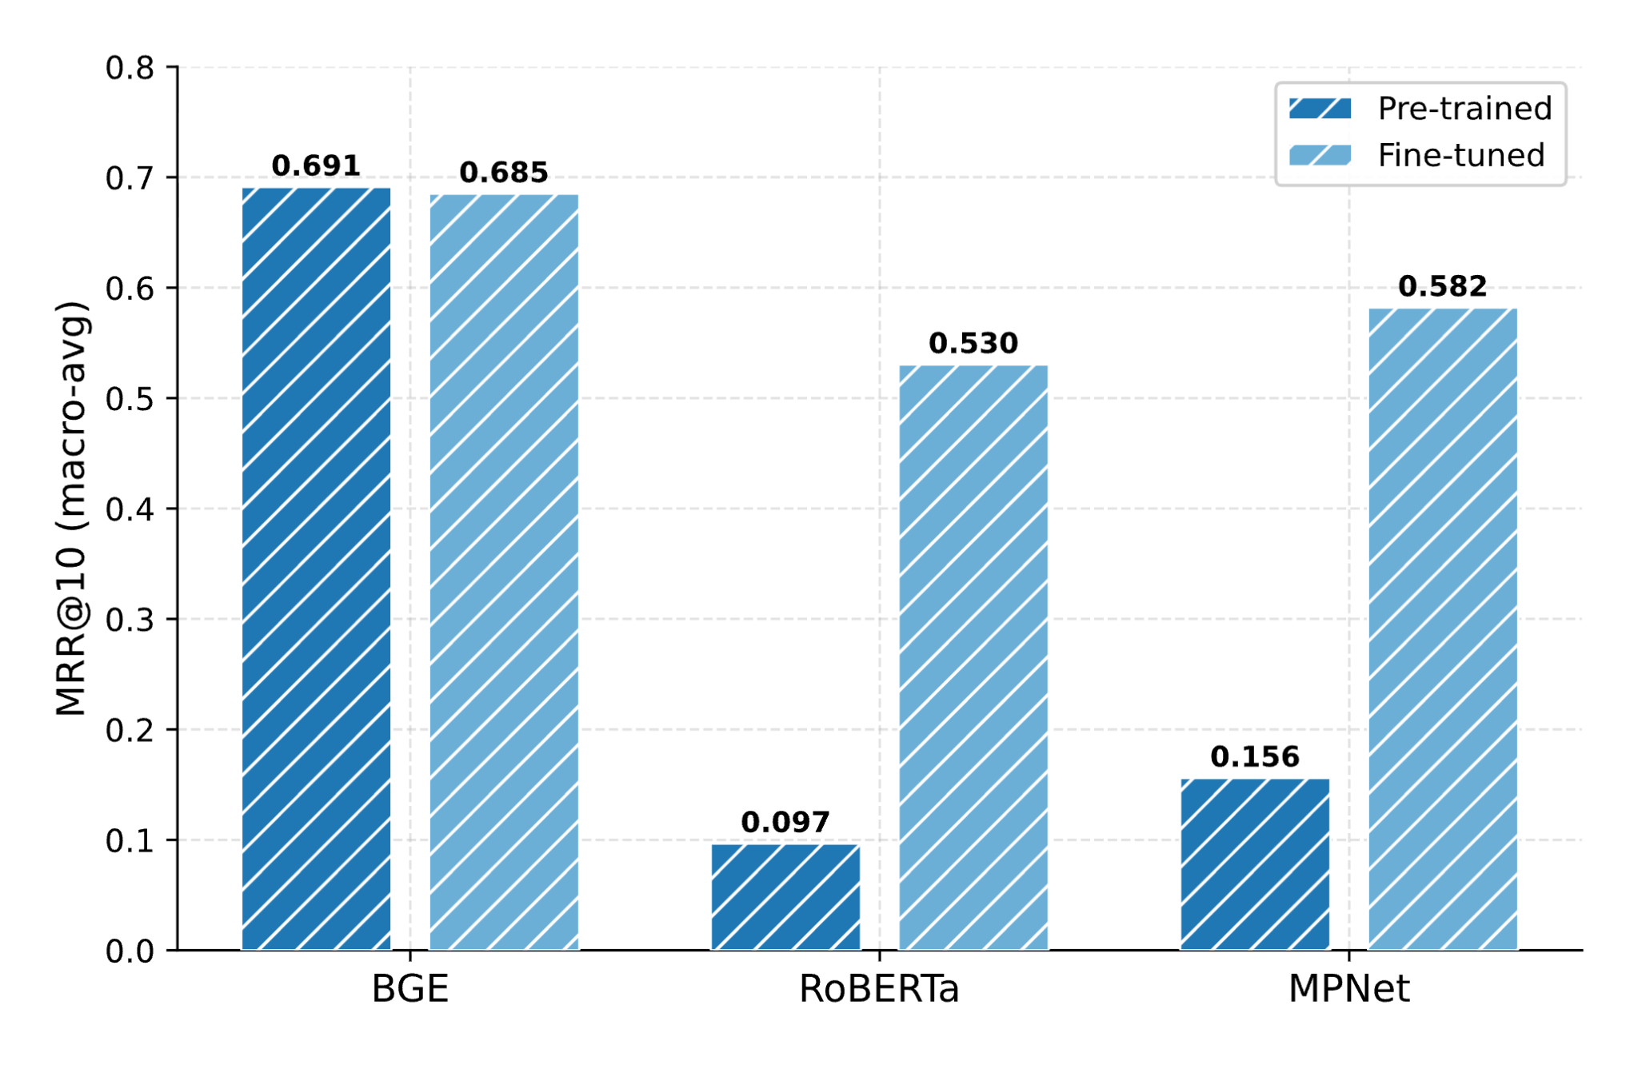
Float32 Baseline
Results and Findings
p = 0.49 > 0.05
Not Significant
Notes:
Let's start the result with the float 32 uncompressed baseline. For the pretrained model.
BGE has has the best retrieval, Roberta has the worst and MPnet is somewhere in between.
This is completely expected.
Also after fine tuning,
the bge performance barely change.
The statistical difference between the score is not significant too.
For Roberta and Mpnet, the performance improve a lot because they were never trained on retrieval task.

Slide 45
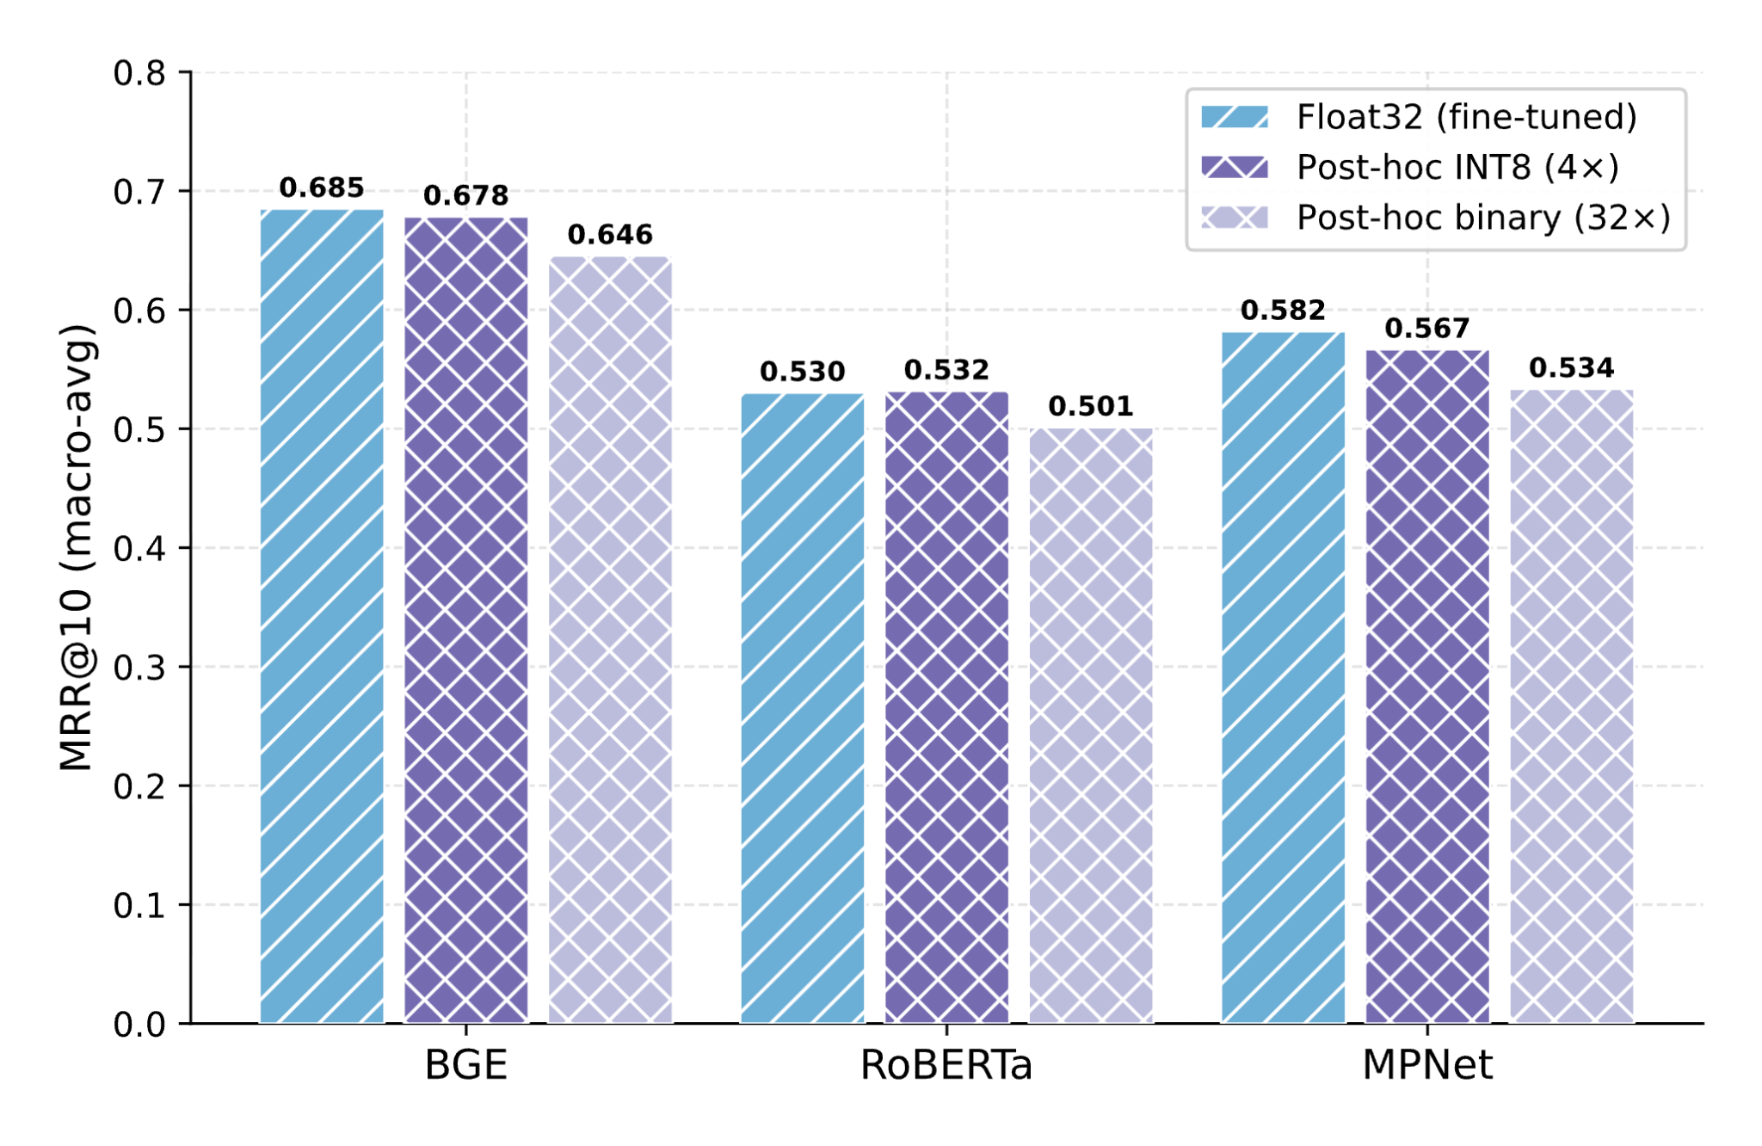
Post-hoc INT8 and Binary
Results and Findings
INT8 is near lossless (p=0.076, 0.783, 0.103)
Binary drops 3–5 % (p < 0.001 for all models)
Notes:
For the INT8 and Binary which are both post hoc methods, we observe
Near lossless performance for INT* for all 3 backbones
But for binary, we can see about 3 to 5 % drop in performance

Slide 46
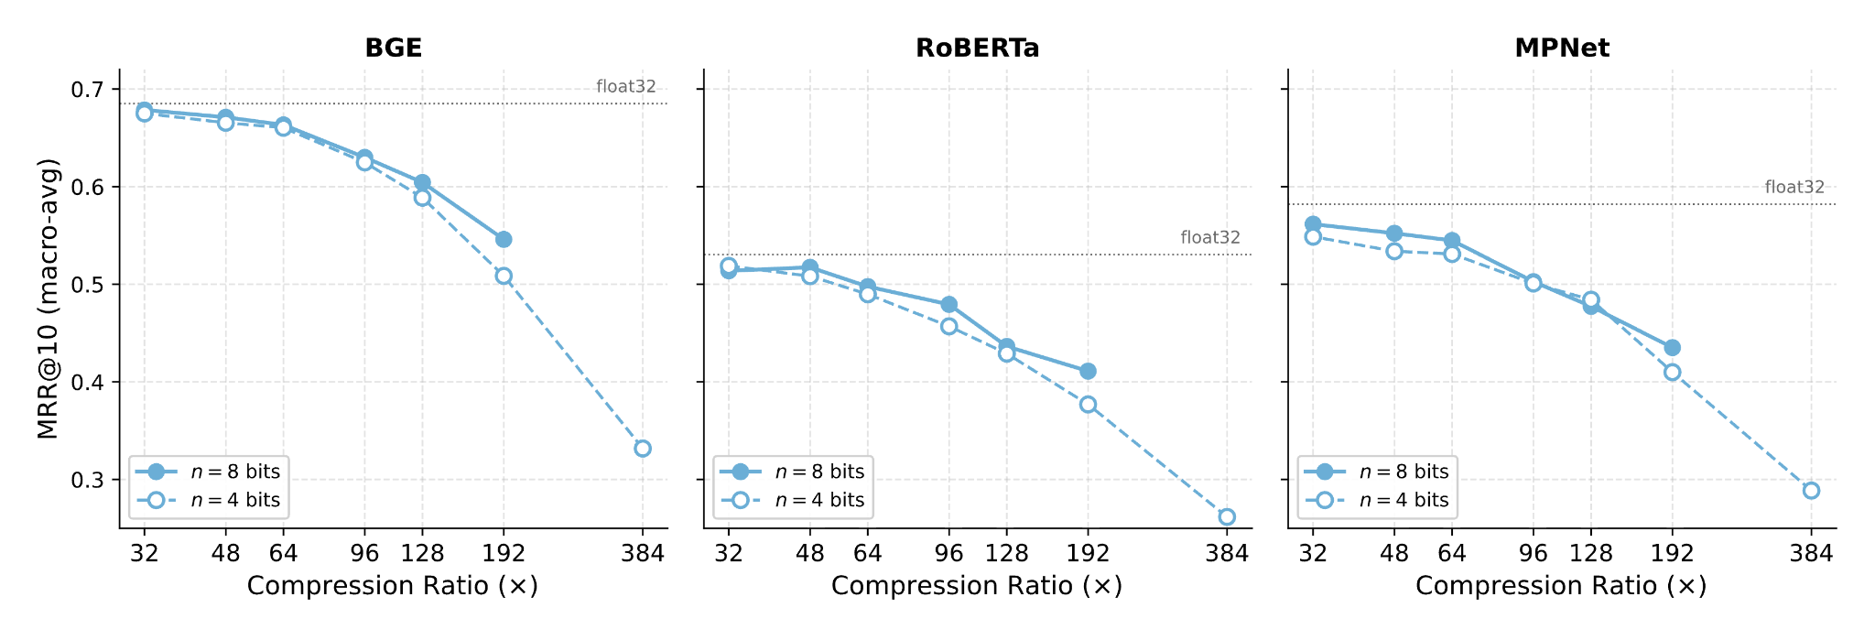
Product Quantization (post-hoc)
Results and Findings
PQ at 32× near-lossless
n=8 bits beats n=4
collapses past ~96×
Notes:
Setup
For product quantization, we tried various parameter settings, which give different compression ratios.
Each backbone has two lines: the solid line is PQ with 8 bits per code, the dotted line is 4 bits per code.
Near-lossless at 32×
Starting at 32×, PQ is near-lossless, especially for BGE, where it sits right on the float32 line.
8 bits beats 4 bits
The solid line which is 8 bit beats the 4 bit in all compression ratio
Collapse past ~96×
Performance holds up well until about 96×, after which it starts to collapse on all three backbones.

Slide 47
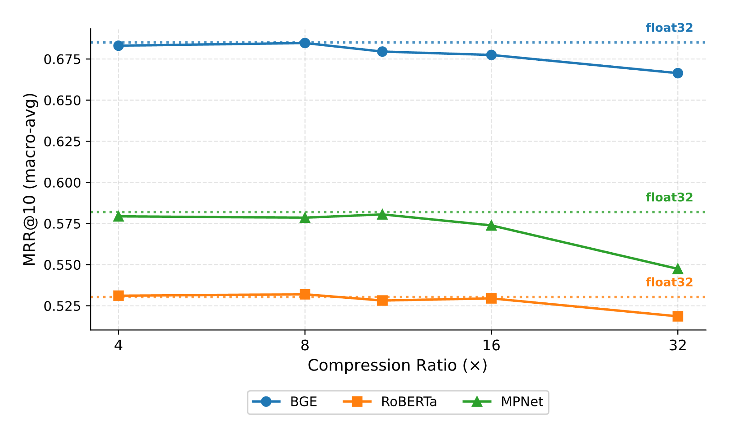
TurboQuant (post-hoc)
Results and Findings
TQ-1 bit (32×) loses only ~2–3.5 %
Near Lossless upto TQ-4 bit (8x)
Notes:
We tested Turbo-Quant and it is doing really good. At 32x compression we can see about 2-3.5% drop in performance.
At lower compression ratios, its is doing near lossless compression for all the backbones.

Slide 48
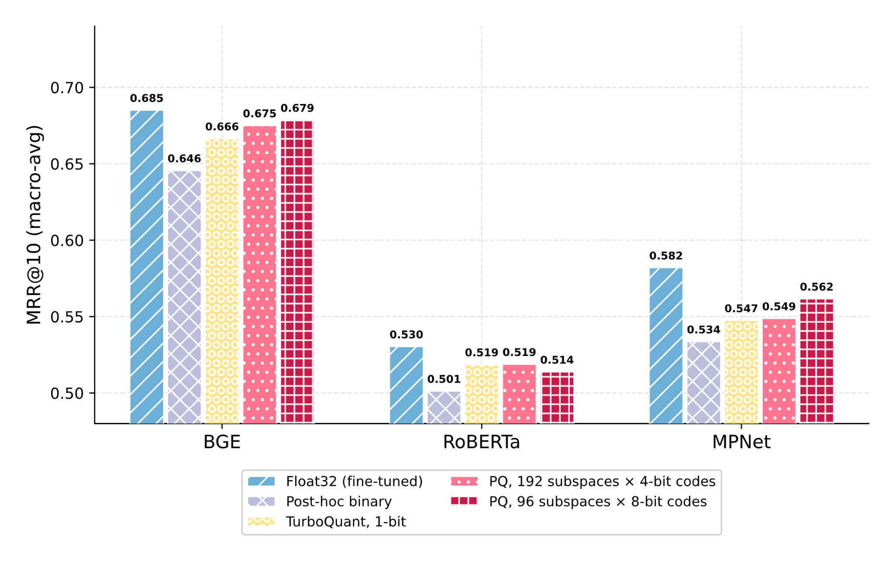
Post-hoc Cross method Compression at 32x
Results and Findings
Ordering PQ > TQ-1 bit > Binary, stable across backbones
Notes:
This chart compares all the post hoc compression methods at 32x compression.
The two pink bar are PQ and it dominates for all backbones.
TQ is in the 2nd place and simple binarization is in the third place.
This orderding holds for all backbones

Slide 49
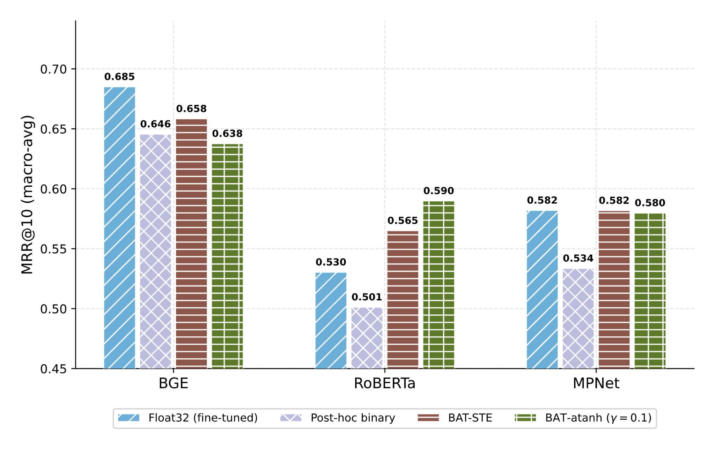
STE vs Annealed Tanh (32x)
Results and Findings
Backbone dependent performance
Notes:
What this slide shows
Compares the two binarization-aware training (BAT) techniques, STE and annealed tanh
Also against post-hoc binarization and the full-precision fine-tuned baseline
Across all three backbones
BAT beats post-hoc binarization
Results are mixed by backbone, but one thing holds everywhere
On all three backbones, BAT beats post-hoc binarization
STE vs annealed tanh is a close call
Between the two BAT methods, the competition is tight
Neither dominates on all three backbones
Interesting Result: RoBERTa
BAT models, despite 32x compression, beat the uncompressed fp32 baseline
Clear margin: +3.5% (STE), +6% (atanh)
Even MPNet's BAT is near-lossless in the same setting
For well trained model for retrieval like BGE don’t show this pattern

Slide 50
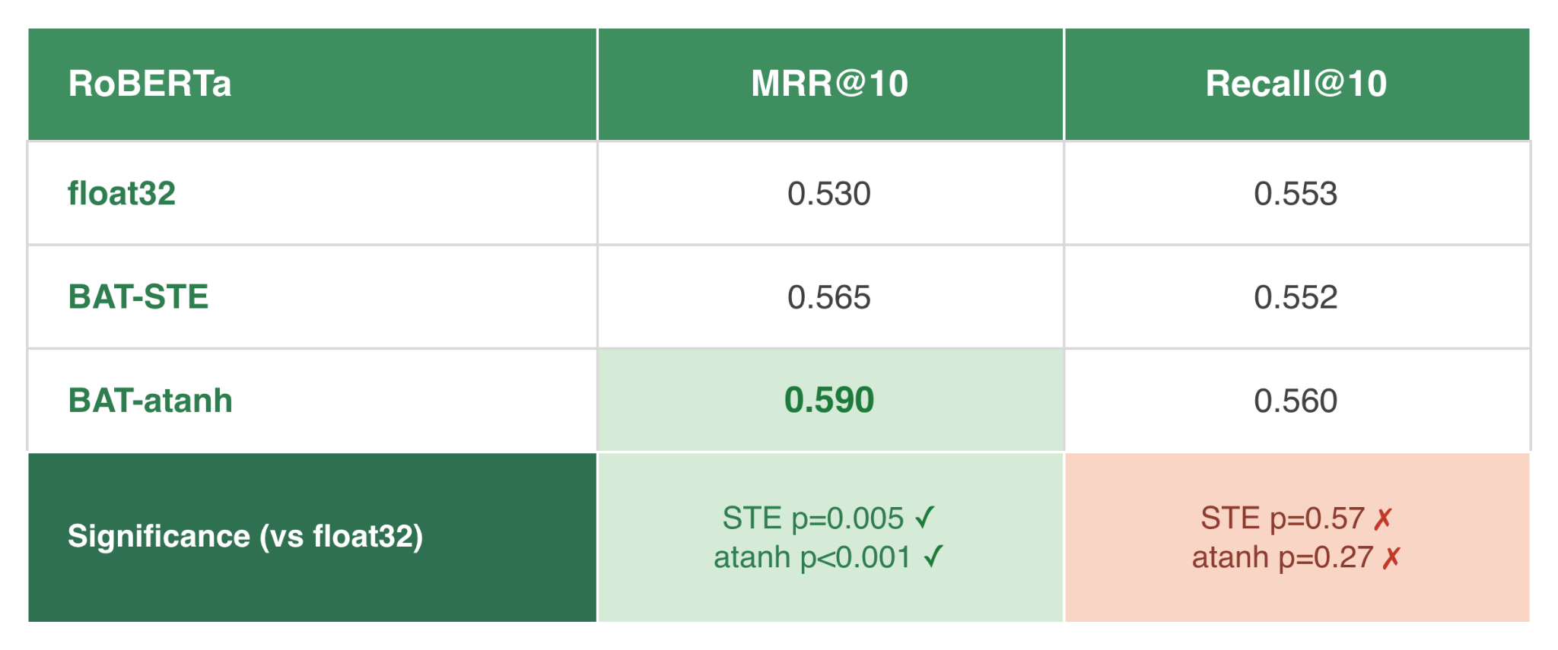
Investigation of BAT vs float32 on RoBERTa
Results and Findings
Recall@10 tells a different story
Recall ignores rank
considers multiple correct results
BAT method retrieves same set of documents but order them better
Notes:
To further investigate, why BAT versions of roberta beat the uncompressed version.
We also looked at the recall@10 and it tells different story.
What Recall@10 shows
BAT versions perform similar to with the float32 baseline on recall
Wilcoxon significance test confirms that there is no significant difference
Why the two metrics disagree
Recall ignores rank, it only checks coverage
But MRR is rank-sensitive,

Slide 51
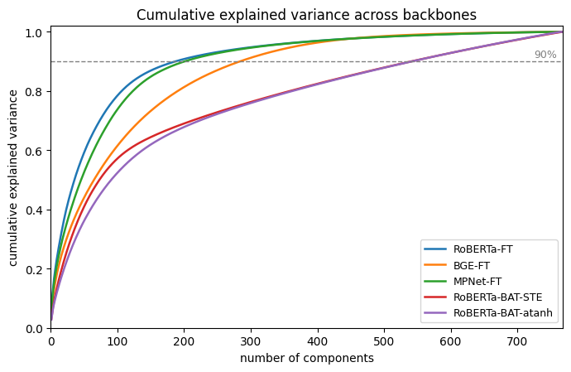
Why BAT orders results better ? Geometry
Results and Findings
RoBERTa
Information stored in narrow dimension
Hard to rank similar documents
RoBERTa-BAT
Information spread
Notes:
But why are BAT version better at ranking as well as getting the right results ?
The answer is in the geometry of the embedding space
Reading the chart
Shows cumulative explained variance as we add principal components
Same plot used to pick the top components in PCA
RoBERTa float (the problem)
RoBERTa-FT has the steepest curve
Its information is packed into a small effective dimension
When embeddings are squeezed like this, similar documents look almost identical, so ranking them is hard
RoBERTa-BAT (the fix)
The BAT versions have the most spread-out curves
That extra separation makes similar documents easier to tell apart, so ranking improves

Slide 52
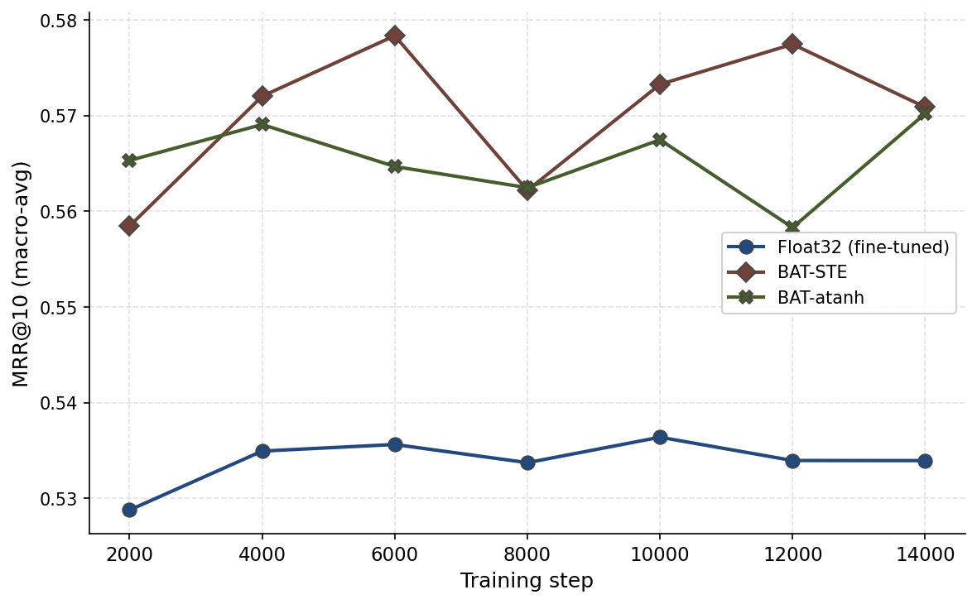
Experiment: Training Trajectory
Results and Findings
Notes:
But why are BAT version better at ranking as well as getting the right results ?
The answer is in the geometry of the embedding space
Reading the chart
Shows cumulative explained variance as we add principal components
Same plot used to pick the top components in PCA
RoBERTa float (the problem)
RoBERTa-FT has the steepest curve
Its information is packed into a small effective dimension
When embeddings are squeezed like this, similar documents look almost identical, so ranking them is hard
RoBERTa-BAT (the fix)
The BAT versions have the most spread-out curves
That extra separation makes similar documents easier to tell apart, so ranking improves

Slide 53
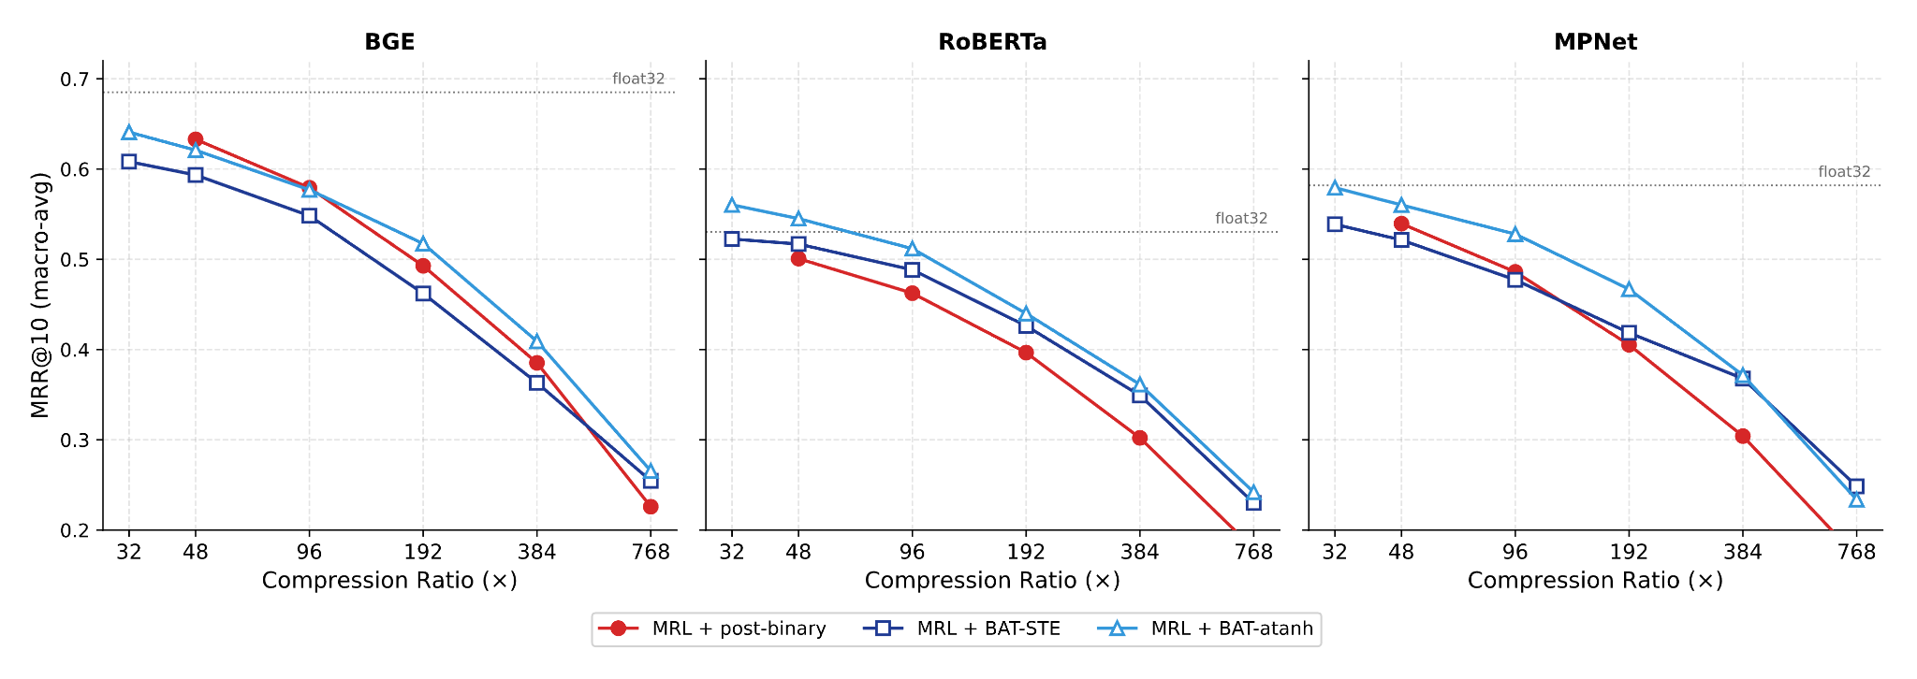
STE vs Annealed Tanh (Stacked with MRL)
Results and Findings
(MRL + Atanh) beats (MRL + STE) in all backbone and compression ratios
Reason: In forward bass Sign binaries before the loss, killing more magnitude info than tanh
Notes:
Let continue the competition of STE with Annealed tanh but this time when we stack it with MRL.
We can see that MRL + Atanh beats MRL+STE for all backbones and compression ratios
The reasons is that the sin() function used for STE during forward pass removes a lot of floating point information required to compute better gradients.

Slide 54
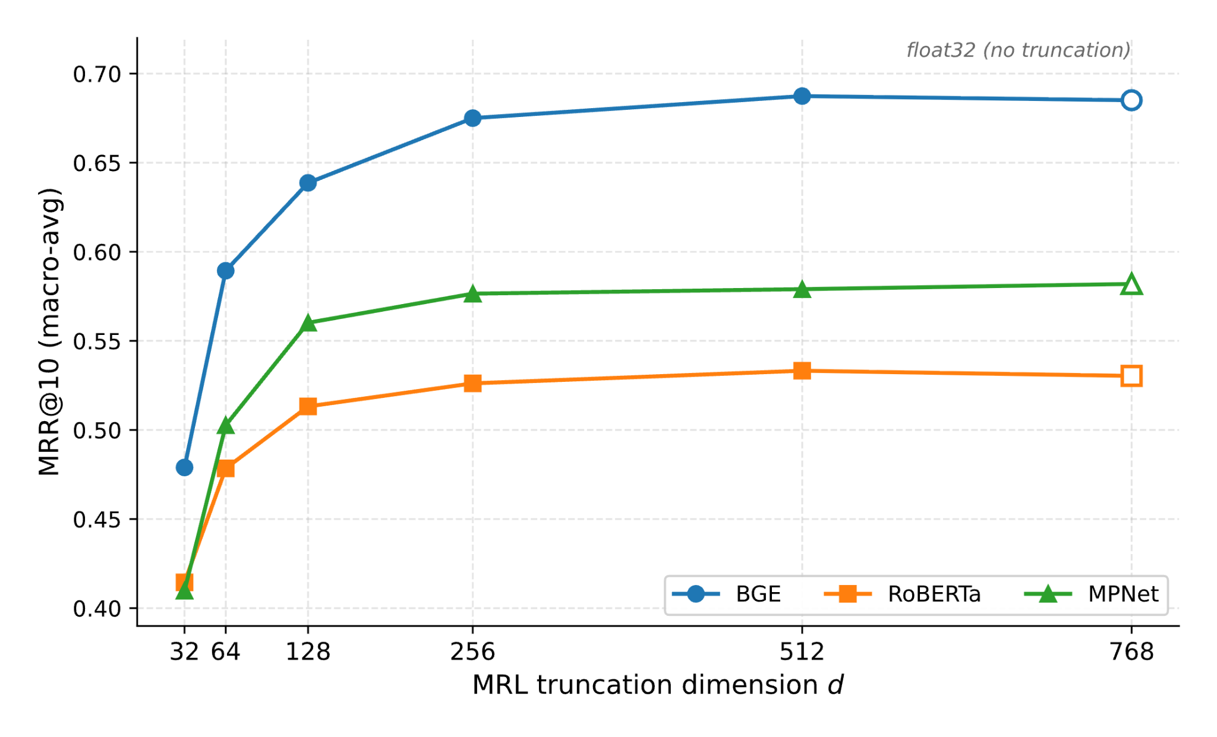
MRL alone
Results and Findings
Performance collapses after 128 d truncation
Notes:
If we were to use MRL alone, the performance drops as we truncate more and more and starts to collapse after 128 d

Slide 55
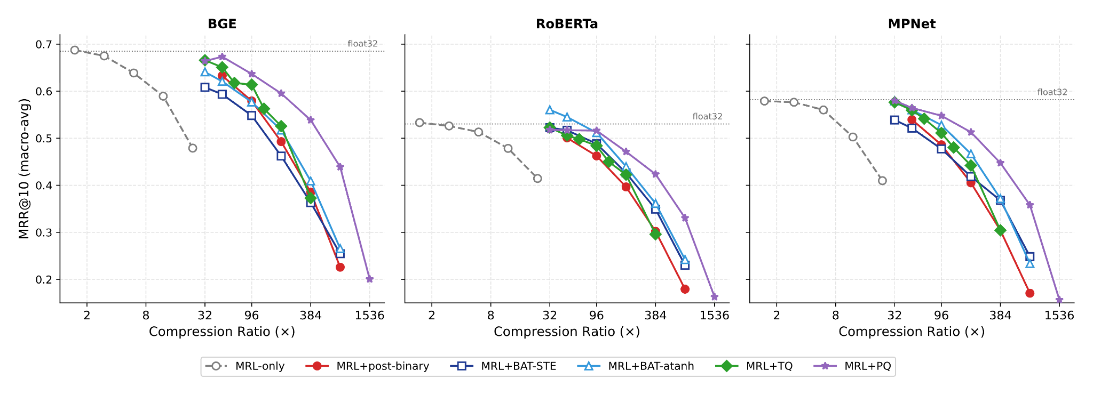
Stacking MRL (Overall)
Results and Findings
MRL stacking: more compression, same retrieval quality
MRL + PQ dominates at high compression
Notes:
What this slide shows
The charts shows the retrieval performance at various compression ratios when stacking MRL with other techniques.
Why stack MRL
Stacking MRL pushes compression much higher while holding retrieval quality
The key result
At high compression, MRL + PQ dominates in all backbones

Slide 56
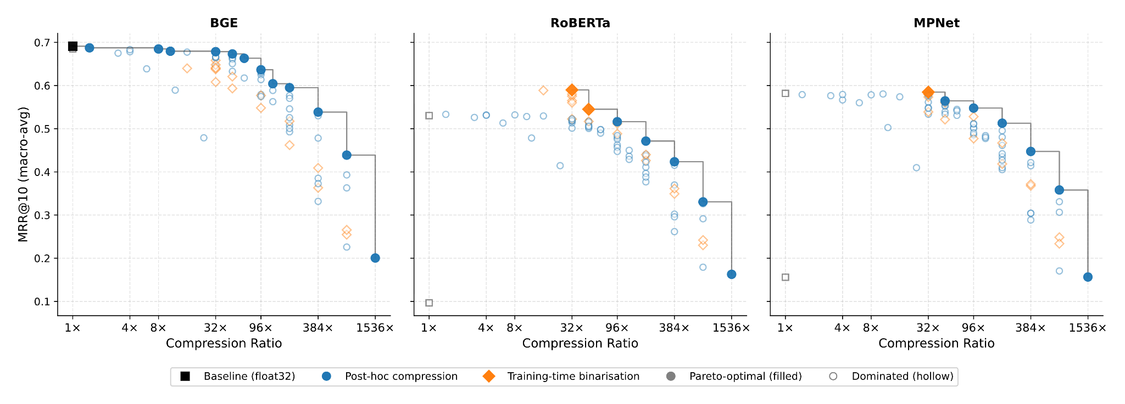
Pareto Frontiers
Results and Findings
No method wins everywhere
Notes:
This shows the pareto frontier of the compression ratio vs performance tradeoff.
The Post-hoc seem to dominate the frontier except at 32x compression.

Slide 57
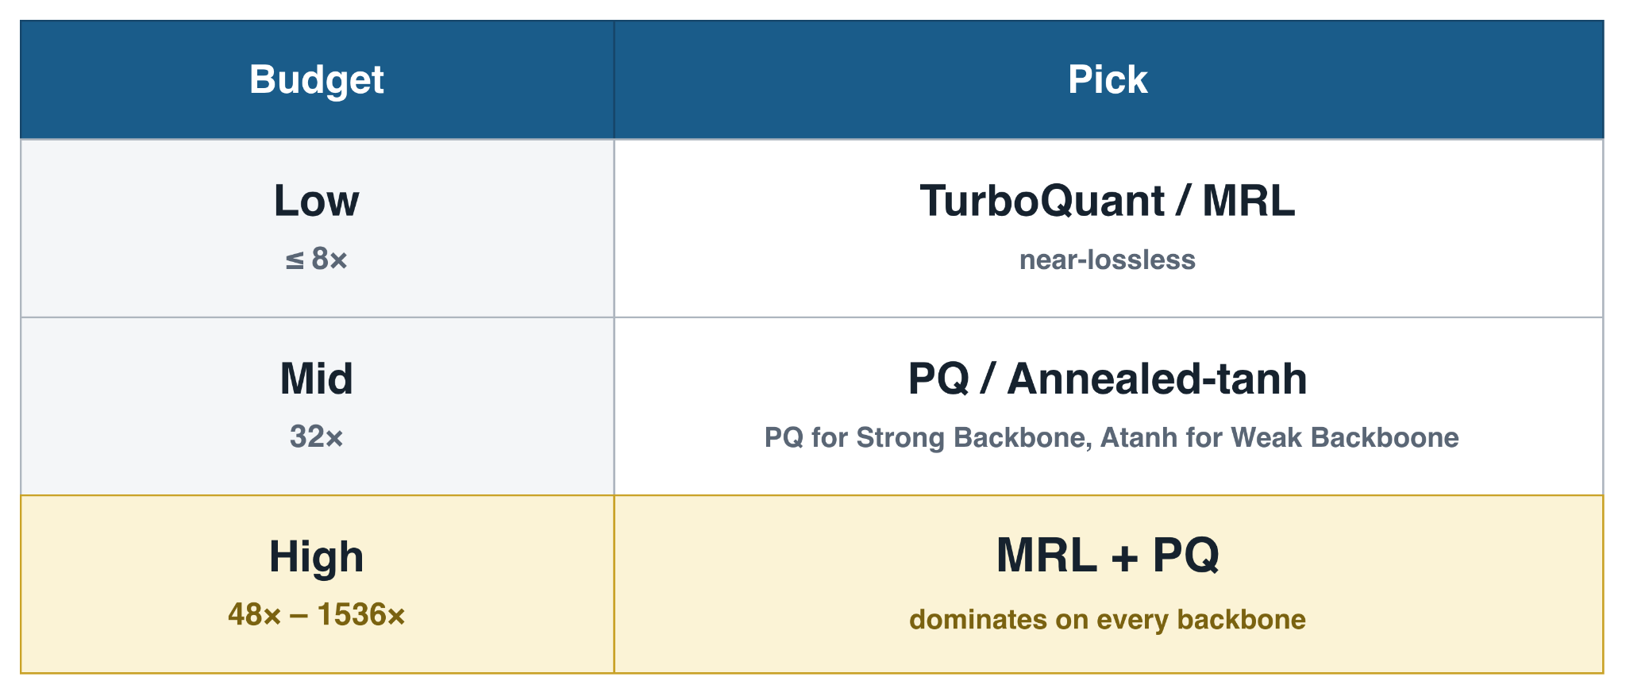
Compression Cheat Sheet
Results and Findings
Notes:
We also came up with this cheat sheet, that would be helpful for the engineers.

Slide 58
Conclusion & Future Work

Slide 59
Recalling Research Question
Conclusion and Future Work
RQ1: Post-hoc vs training-time?
Depends on backbone
PQ wins for BGE
Training-Time BAT wins on RoBERTa / MPNet
RQ2: STE vs annealed tanh?
In standalone
Depends on backbone
Atanh wins on RoBERTa
STE wins for BGE
When stacked with MRL
MRL + atanh beats MRL + STE
Notes:
Let's conclude the presentation recalling our research question

Slide 60
Recalling Research Question
Conclusion and Future Work
RQ3: Does stacking help?
Yes
E.g. MRL + PQ dominates ≥96×, beyond either method alone
RQ4: Do findings generalize across backbones?
In many cases it doesn't

Slide 61
Takeaway
Conclusion and Future Work
No universal winner
Choose by: retrieval pre-training and memory budget

Slide 62
Future Works
Conclusion and Future Work
Scale Evaluation & Training
Full BEIR Evaluation
Larger Training data
Longer training runs
MRL + recurrent residual binary (with atanh)
Flexible inference time truncation and bit depth (BEBR)

Slide 63
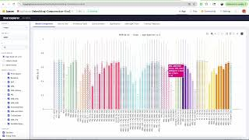
Demo for Evaluation Dashboard
https://huggingface.co/spaces/SajilAwale/Embedding-Compression-Eval

Slide 64
Thank you !

